Slide 1
Logic and Induction
Logic is a set or a system of principles or rules.
The rules of logic give precise meaning to mathematical statements.
These rules are used to distinguish between valid and invalid mathematical arguments and specify the meaning of mathematical statements.
Logic is the basis of all mathematical reasoning, and of all automated reasoning.
These rules are used in the design of computer circuits, the construction of computer programs, the verification of the correctness of programs, and in many other ways.

Slide 2
Logic and Induction
Propositional logic
Predicate logic
Mathematical Induction

Slide 3
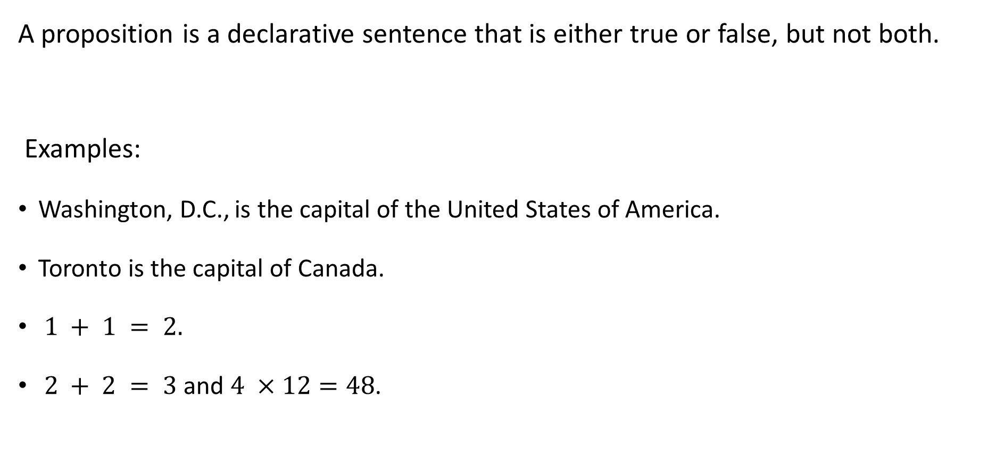
Proposition or Statement
A proposition is a declarative sentence that is either true or false, but not both.
Examples:
Washington, D.C., is the capital of the United States of America.
Toronto is the capital of Canada.
$1 + 1 = 2.$
$2 + 2 = 3$ and $4 ×12=48$.

Slide 4

Examples
What time is it?
Read this carefully.
$x + 1 = 2$.
$x + y = z$.
These are not propositions

Slide 5
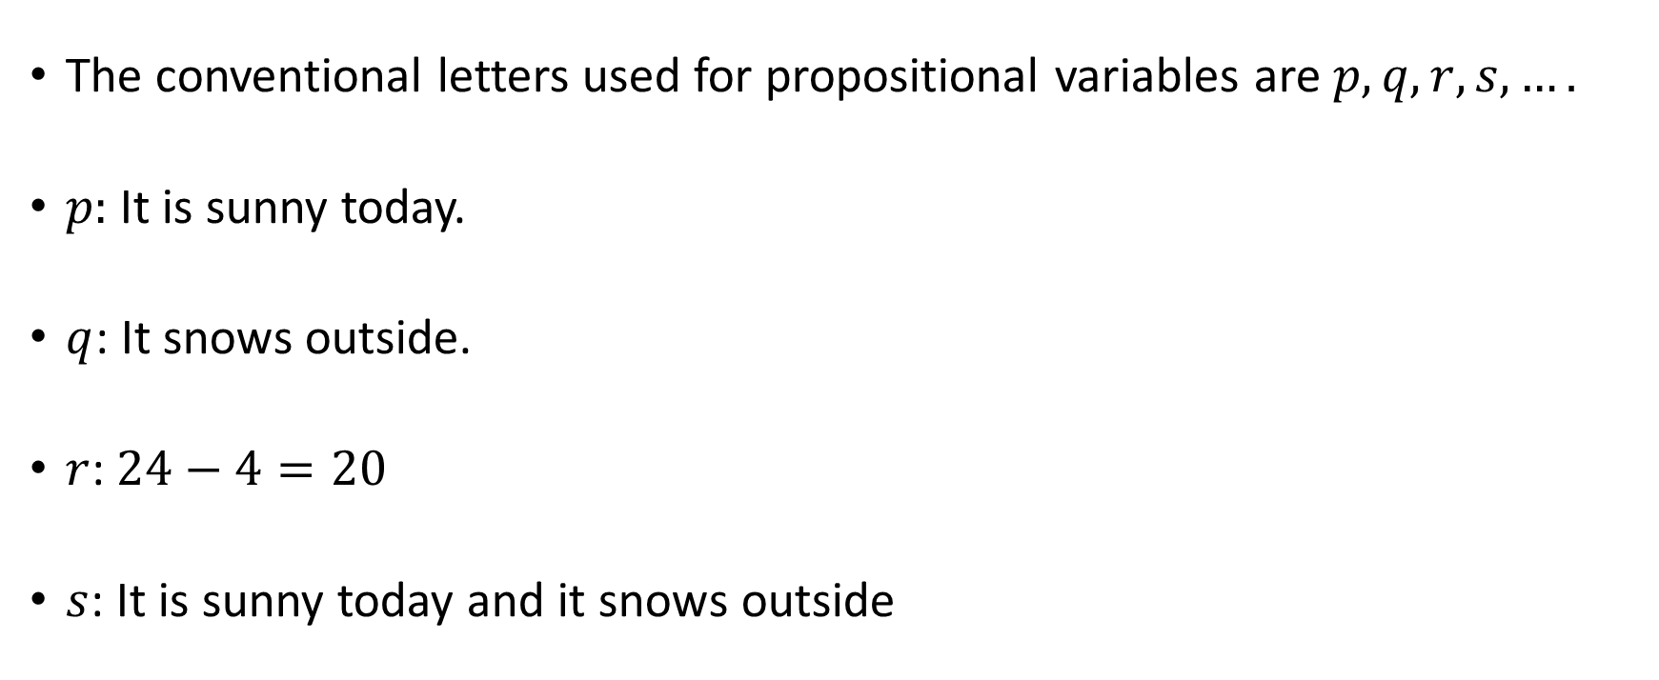
Propositional Variables
The conventional letters used for propositional variables are $p, q, r, s, ….$
$p:$ It is sunny today.
$q$: It snows outside.
$r$:$24−4=20$
$s$: It is sunny today and it snows outside

Slide 6
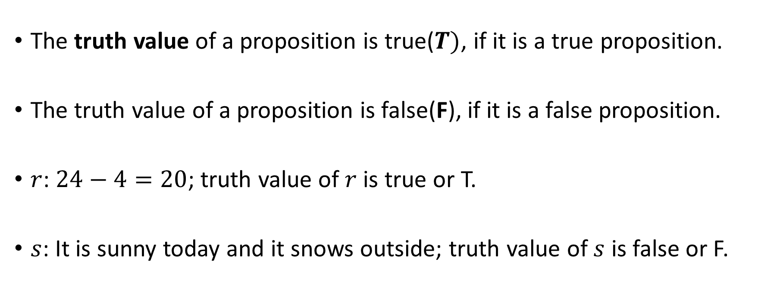
Truth Value of Propositions
The truth value of a proposition is true($T)$, if it is a true proposition.
The truth value of a proposition is false(F), if it is a false proposition.
$r$:$24−4=20$; truth value of $r$ is true or T.
$s$: It is sunny today and it snows outside; truth value of $s$ is false or F.

Slide 7
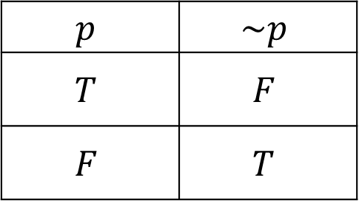

Negation
The negation of a proposition $p$, is the statement
“It is not the case that $p$.”
The negation of $p$, denoted by $\sim p$.
Truth Table
$$p$$ | $$\sim p$$
$$T$$ | $$F$$
$$F$$ | $$T$$

Slide 8
Example
Find the negation of the proposition
“Michael’s PC runs Linux”
and express this in simple English.
Solution: The negation is
“It is not the case that Michael’s PC runs Linux.”
This negation can be more simply expressed as
“Michael’s PC does not run Linux.”

Slide 9
Example
Find the negation of the proposition
“Vandana’s smartphone has at least 32GB of memory”
and express this in simple English.
Solution: The negation is
“It is not the case that Vandana’s smartphone has at least 32GB of memory.”
This negation can also be expressed as
“Vandana’s smartphone does not have at least 32GB of memory”
or even more simply as
“Vandana’s smartphone has less than 32GB of memory.”

Slide 10
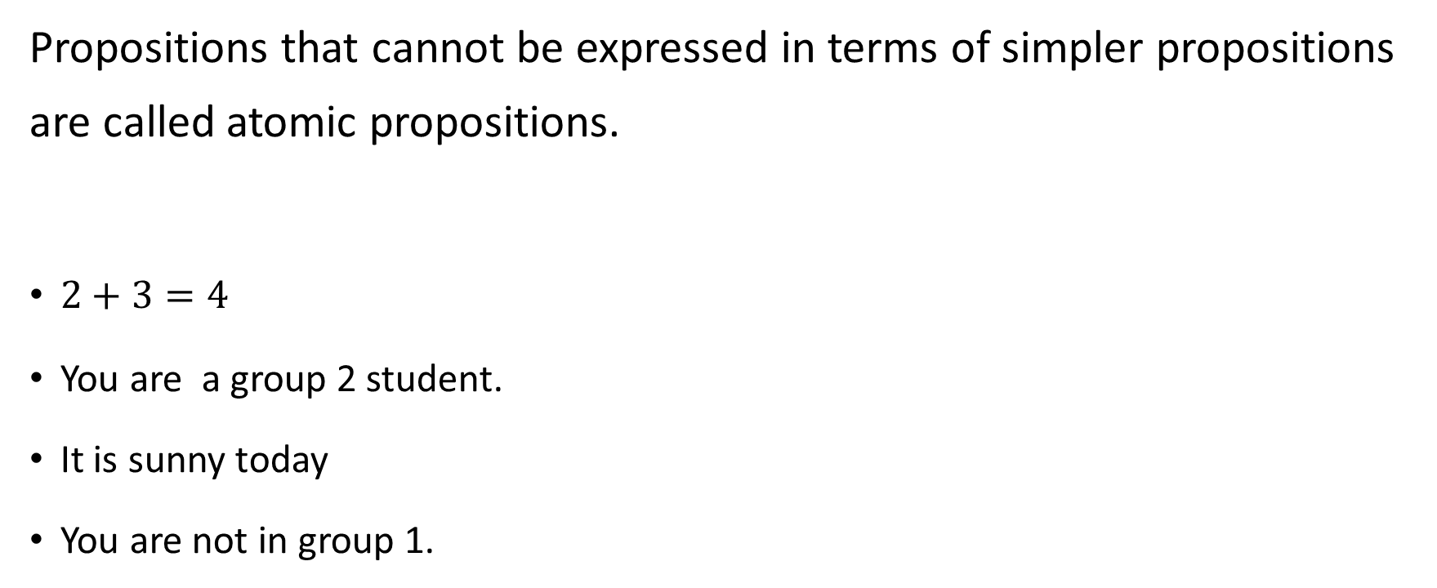
Atomic propositions
Propositions that cannot be expressed in terms of simpler propositions are called atomic propositions.
$2+3=4$
You are a group 2 student.
It is sunny today
You are not in group 1.

Slide 11
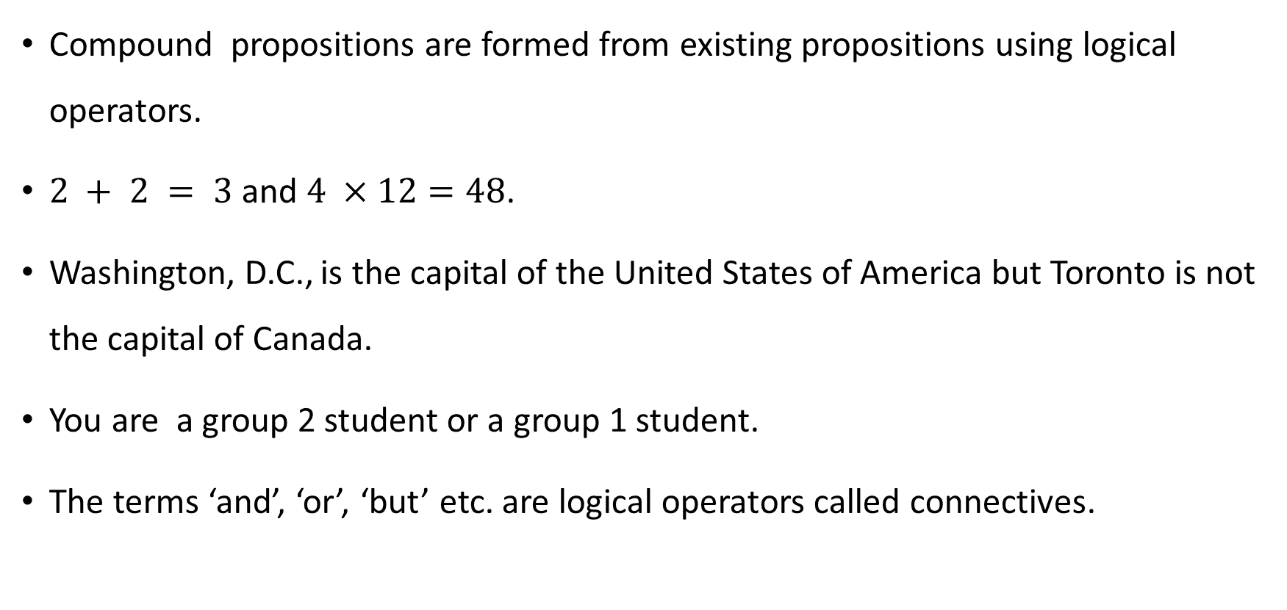
Compound propositions
Compound propositions are formed from existing propositions using logical operators.
$2 + 2 = 3$ and $4 ×12=48$.
Washington, D.C., is the capital of the United States of America but Toronto is not the capital of Canada.
You are a group 2 student or a group 1 student.
The terms ‘and’, ‘or’, ‘but’ etc. are logical operators called connectives.

Slide 12
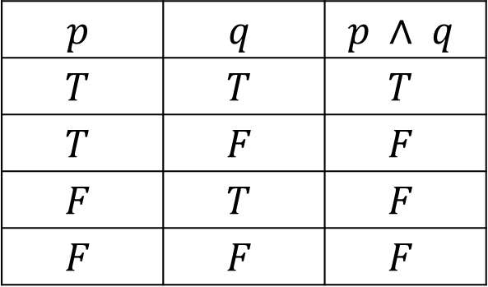

Conjunction
The conjunction of $p$ and $q$ is the proposition “$p$ and $q$.”
Conjunction of $p$ and $q$ is denoted by $p ∧q$.
The conjunction $p ∧ q$ is true when both $p$ and $q$ are true and is false otherwise.
$$p$$ | $$q$$ | $$p ∧ q$$
$$T$$ | $$T$$ | $$T$$
$$T$$ | $$F$$ | $$F$$
$$F$$ | $$T$$ | $$F$$
$$F$$ | $$F$$ | $$F$$

Slide 13
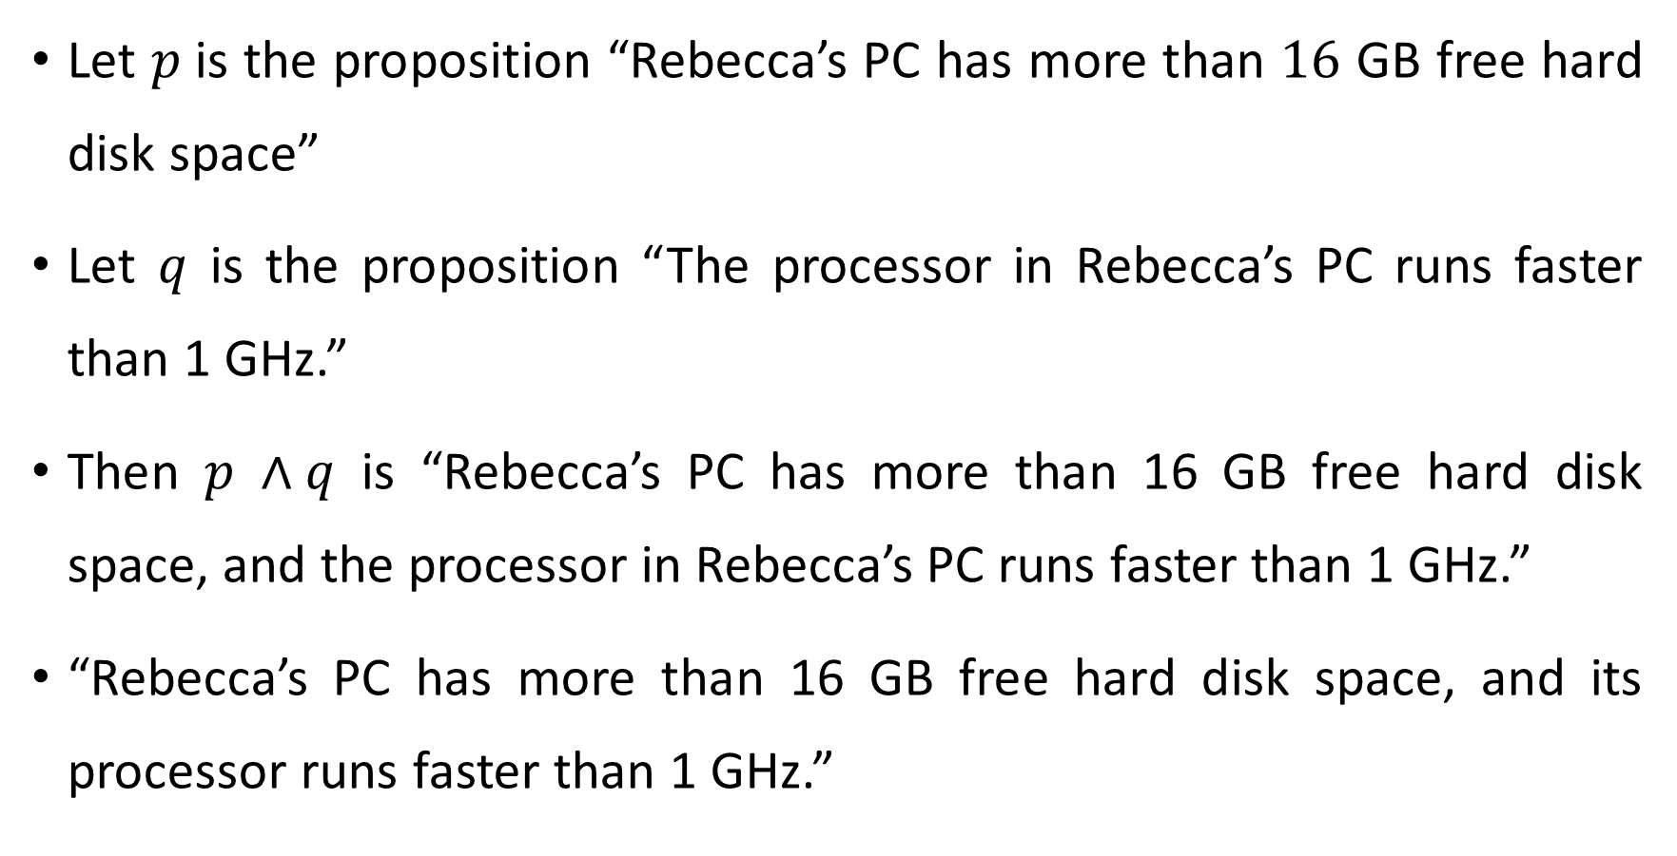
Example
Let $p$is the proposition “Rebecca’s PC has more than $16$ GB free hard disk space”
Let $q$ is the proposition “The processor in Rebecca’s PC runs faster than 1 GHz.”
Then $p ∧q$ is “Rebecca’s PC has more than 16 GB free hard disk space, and the processor in Rebecca’s PC runs faster than 1 GHz.”
“Rebecca’s PC has more than 16 GB free hard disk space, and its processor runs faster than 1 GHz.”

Slide 14
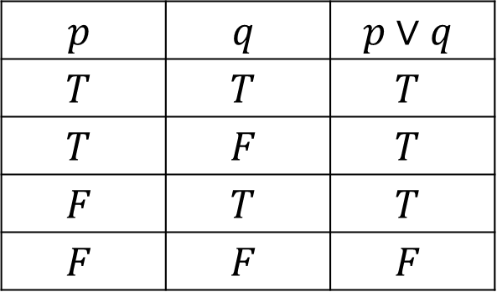

Disjunction
The disjunction of $p$and $q$ is the proposition “$p$or $q$.”
The disjunction of $p$and $q$ is denoted by $p∨q$
The disjunction $p∨q$ is false when both $p$ and $q$ are false and is true otherwise.
$$p$$ | $$q$$ | $$p∨q$$
$$T$$ | $$T$$ | $$T$$
$$T$$ | $$F$$ | $$T$$
$$F$$ | $$T$$ | $$T$$
$$F$$ | $$F$$ | $$F$$

Slide 15
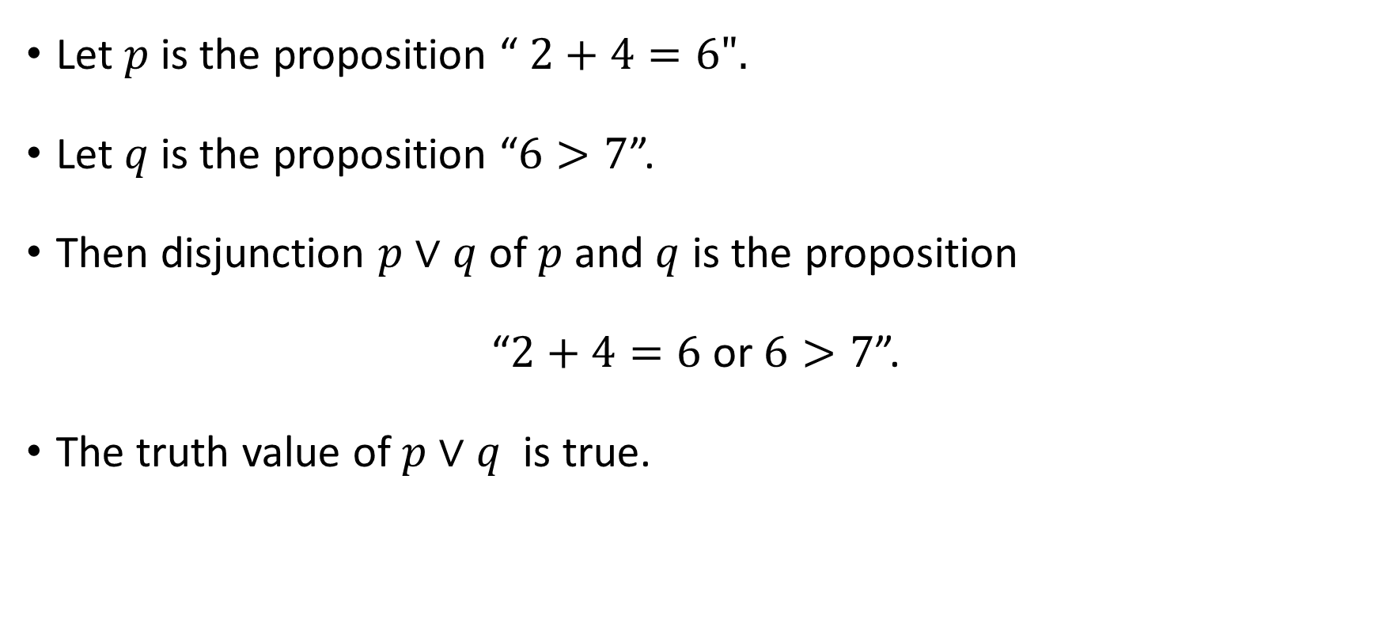
Example
Let $p$is the proposition “ $2+4=6".$
Let $q$is the proposition “$6>7$”.
Then disjunction $p∨q$ of $p$and $q$ is the proposition
“$2+4=6$ or $6>7$”.
The truth value of $p∨q$ is true.

Slide 16
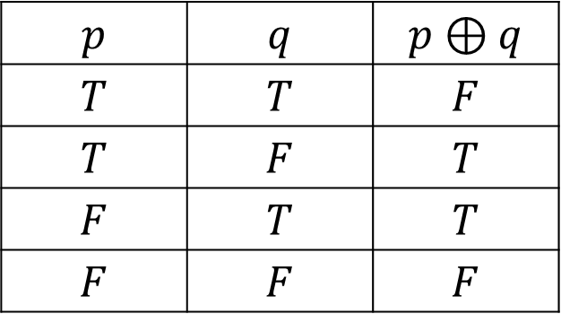

Exclusive or
The exclusive or of $p$and $q$is the proposition “Either $p$ or $q$”.
The exclusive or of $p$and $q$ is denoted by $p ⊕ q$
The proposition $p ⊕ q$ is true when exactly one of $p$ and $q$ is true and is false otherwise.
$$p$$ | $$q$$ | $$p⊕q$$
$$T$$ | $$T$$ | $$F$$
$$T$$ | $$F$$ | $$T$$
$$F$$ | $$T$$ | $$T$$
$$F$$ | $$F$$ | $$F$$

Slide 17
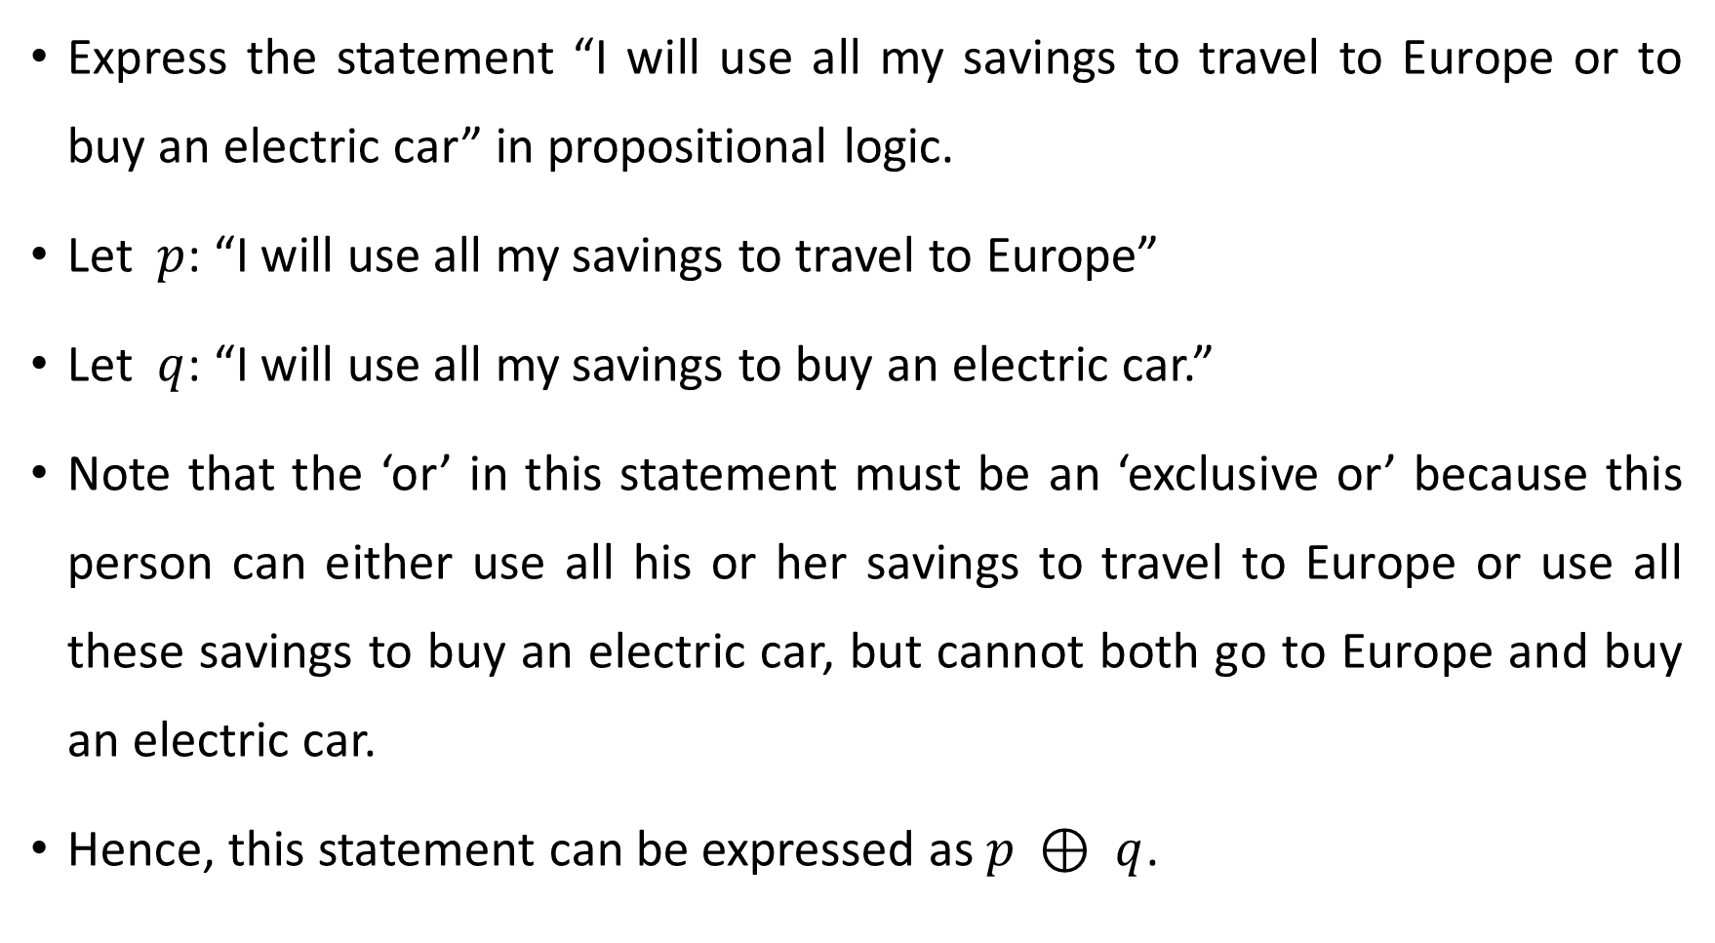
Example
Express the statement “I will use all my savings to travel to Europe or to buy an electric car” in propositional logic.
Let $p$: “I will use all my savings to travel to Europe”
Let $q$: “I will use all my savings to buy an electric car.”
Note that the ‘or’ in this statement must be an ‘exclusive or’ because this person can either use all his or her savings to travel to Europe or use all these savings to buy an electric car, but cannot both go to Europe and buy an electric car.
Hence, this statement can be expressed as $p ⊕ q$.

Slide 18
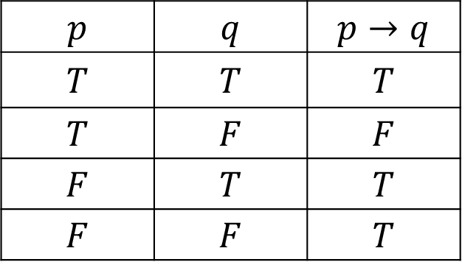
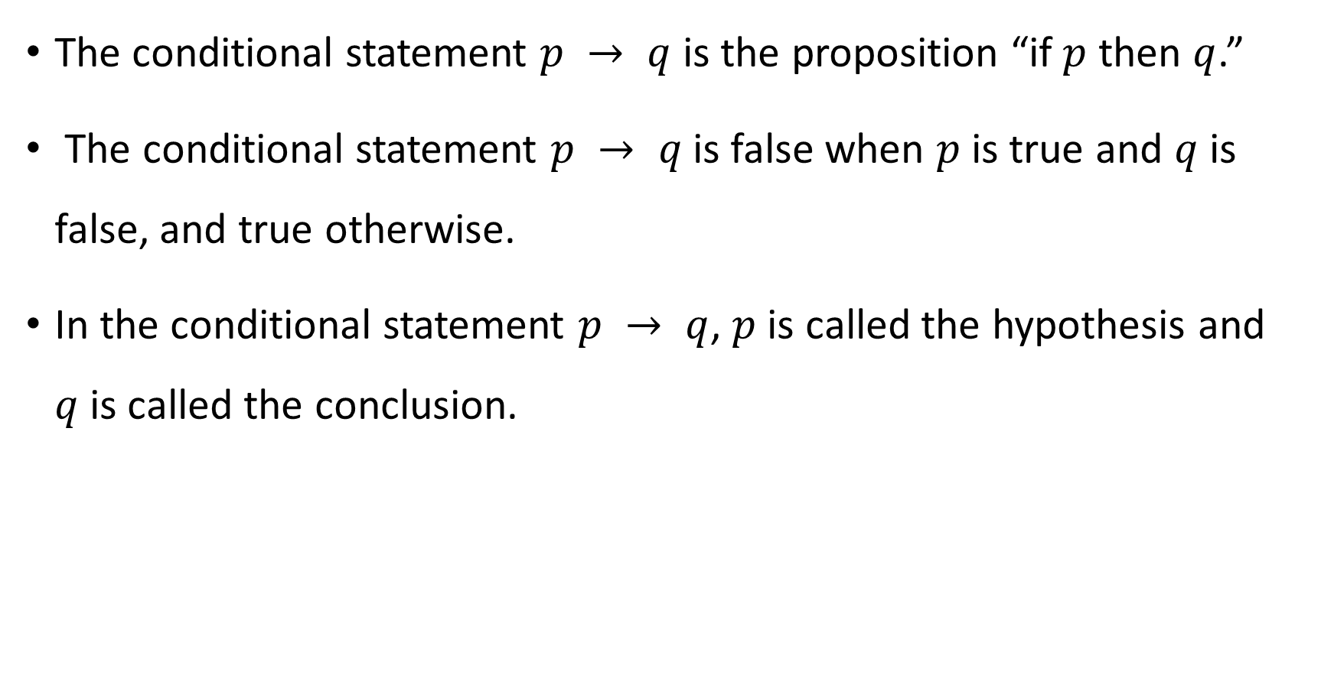
Conditional Statement
The conditional statement $p → q$ is the proposition “if $p$ then $q$.”
The conditional statement $p → q$ is false when $p$ is true and $q$ is false, and true otherwise.
In the conditional statement $p → q$, $p$ is called the hypothesis and $q$is called the conclusion.
$$p$$ | $$q$$ | $$p→q$$
$$T$$ | $$T$$ | $$T$$
$$T$$ | $$F$$ | $$F$$
$$F$$ | $$T$$ | $$T$$
$$F$$ | $$F$$ | $$T$$

Slide 19
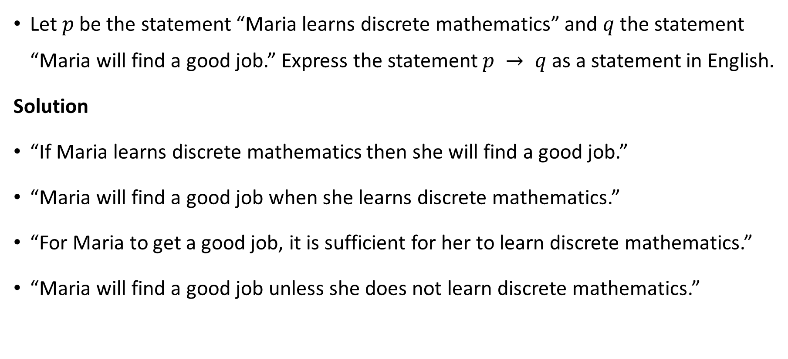
Example
Let $p$ be the statement “Maria learns discrete mathematics” and $q$ the statement “Maria will find a good job.” Express the statement $p → q$ as a statement in English.
Solution
“If Maria learns discrete mathematics then she will find a good job.”
“Maria will find a good job when she learns discrete mathematics.”
“For Maria to get a good job, it is sufficient for her to learn discrete mathematics.”
“Maria will find a good job unless she does not learn discrete mathematics.”

Slide 20
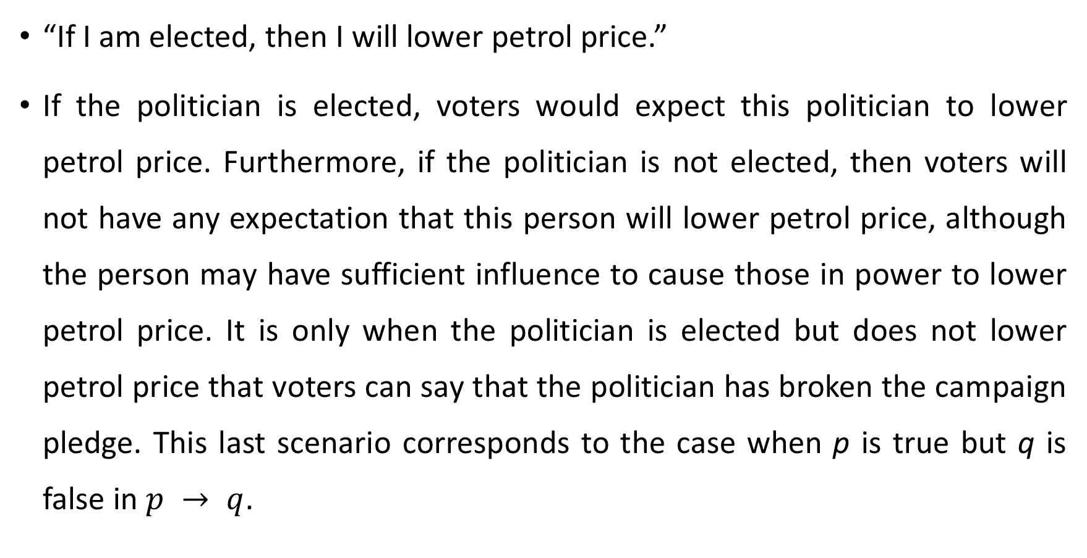
An obligation or a contract
“If I am elected, then I will lower petrol price.”
If the politician is elected, voters would expect this politician to lower petrol price. Furthermore, if the politician is not elected, then voters will not have any expectation that this person will lower petrol price, although the person may have sufficient influence to cause those in power to lower petrol price. It is only when the politician is elected but does not lower petrol price that voters can say that the politician has broken the campaign pledge. This last scenario corresponds to the case when p is true but q is false in $p → q$.

Slide 21
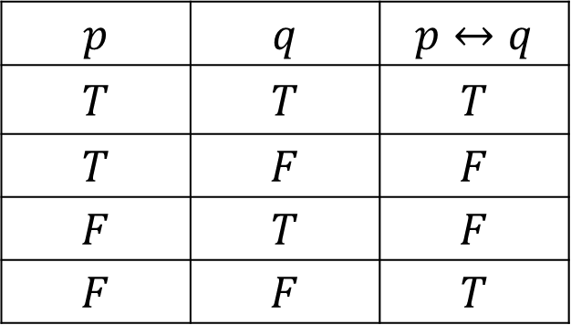
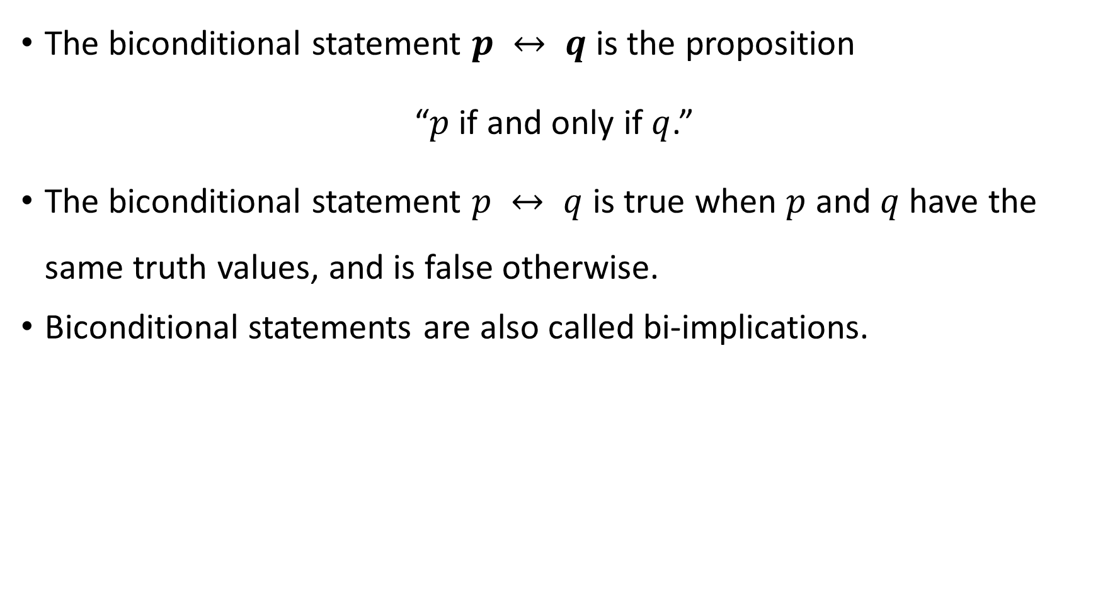
Biconditional Statement
The biconditional statement $p ↔ q$ is the proposition
“$p$if and only if $q$.”
The biconditional statement $p ↔ q$ is true when $p$ and $q$ have the same truth values, and is false otherwise.
Biconditional statements are also called bi-implications.
$$p$$ | $$q$$ | $$p↔q$$
$$T$$ | $$T$$ | $$T$$
$$T$$ | $$F$$ | $$F$$
$$F$$ | $$T$$ | $$F$$
$$F$$ | $$F$$ | $$T$$

Slide 22
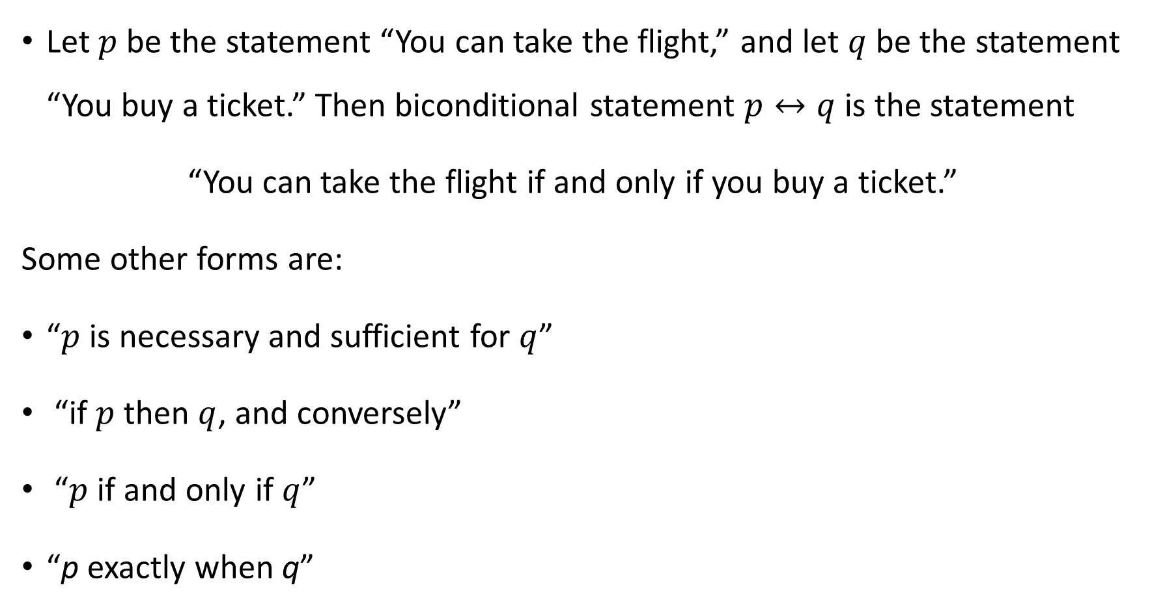
Example
Let $p$ be the statement “You can take the flight,” and let $q$ be the statement “You buy a ticket.” Then biconditional statement $p↔q$ is the statement
“You can take the flight if and only if you buy a ticket.”
Some other forms are:
“$p$ is necessary and sufficient for $q$”
“if $p$ then $q$, and conversely”
“$p$ if and only if $q$”
“p exactly when q”

Slide 23
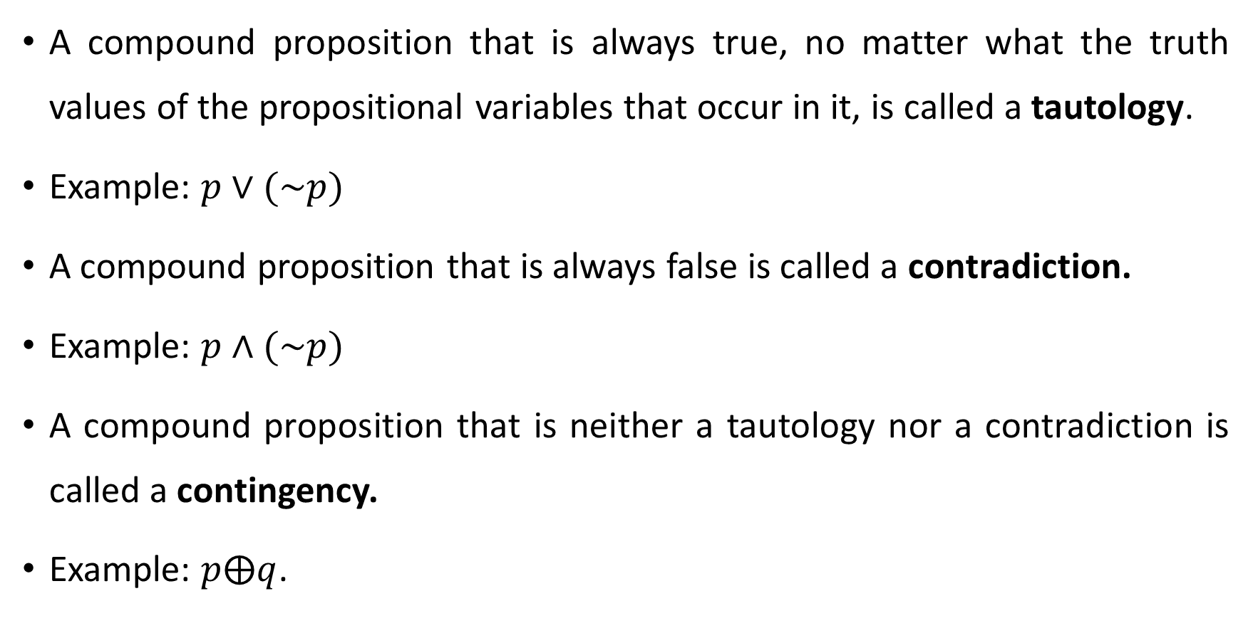
Tautology, contradiction and contingency
A compound proposition that is always true, no matter what the truth values of the propositional variables that occur in it, is called a tautology.
Example: $p∨(\sim p)$
A compound proposition that is always false is called a contradiction.
Example: $p∧(\sim p)$
A compound proposition that is neither a tautology nor a contradiction is called a contingency.
Example: $p⨁q$.

Slide 24
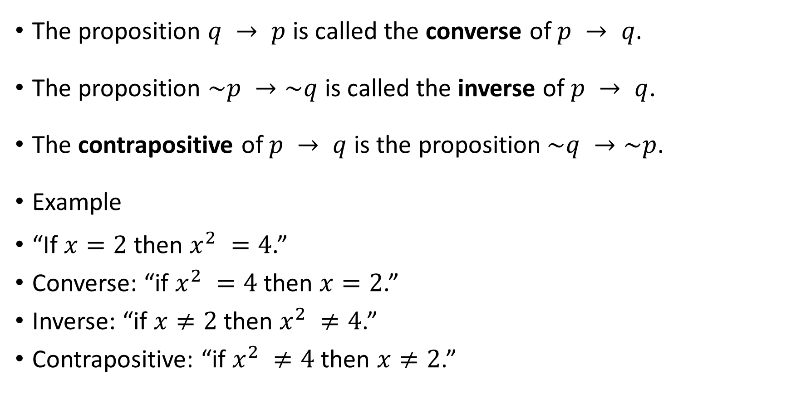
Converse, Inverse, and Contrapositive
The proposition $q → p$ is called the converse of $p → q$.
The proposition $\sim p →\sim q$ is called the inverse of $p → q$.
The contrapositive of $p → q$ is the proposition$\sim q →\sim p$.
Example
“If $x=2$then $x^{2} =4$.”
Converse: “if $x^{2} =4$ then $x=2$.”
Inverse: “if $x≠2$then $x^{2} ≠4$.”
Contrapositive: “if $x^{2} ≠4$ then $x≠2$.”

Slide 25
Example
What are the contrapositive, the converse, and the inverse of the conditional statement
“The home team wins whenever it is raining?”
The original statement can be rewritten as
“If it is raining, then the home team wins.”
Contrapositive: “If the home team does not win, then it is not raining.”
The converse: “If the home team wins, then it is raining.”
The inverse: “If it is not raining, then the home team does not win.”

Slide 26
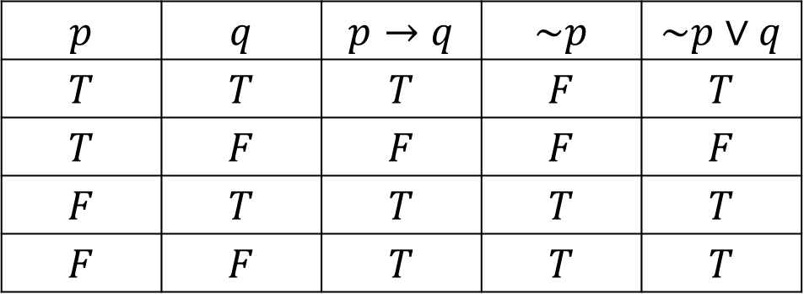
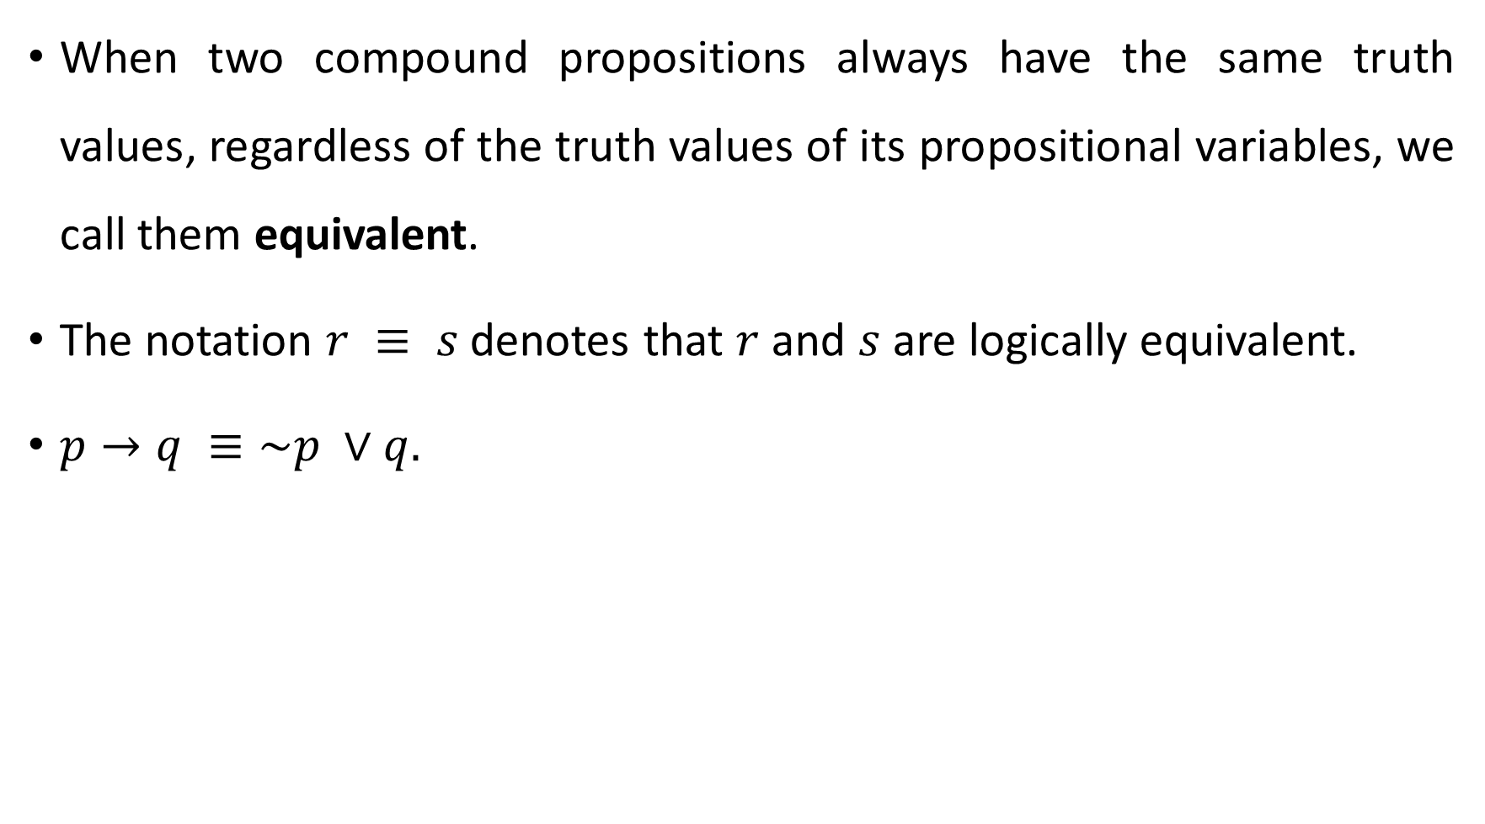
Equivalent Statements
When two compound propositions always have the same truth values, regardless of the truth values of its propositional variables, we call them equivalent.
The notation $r ≡ s$denotes that $r$ and $s$ are logically equivalent.
$p→q ≡\sim p ∨q.$
$$p$$ | $$q$$ | $$p→q$$ | $$\sim p$$ | $$\sim p∨q$$
$$T$$ | $$T$$ | $$T$$ | $$F$$ | $$T$$
$$T$$ | $$F$$ | $$F$$ | $$F$$ | $$F$$
$$F$$ | $$T$$ | $$T$$ | $$T$$ | $$T$$
$$F$$ | $$F$$ | $$T$$ | $$T$$ | $$T$$

Slide 27
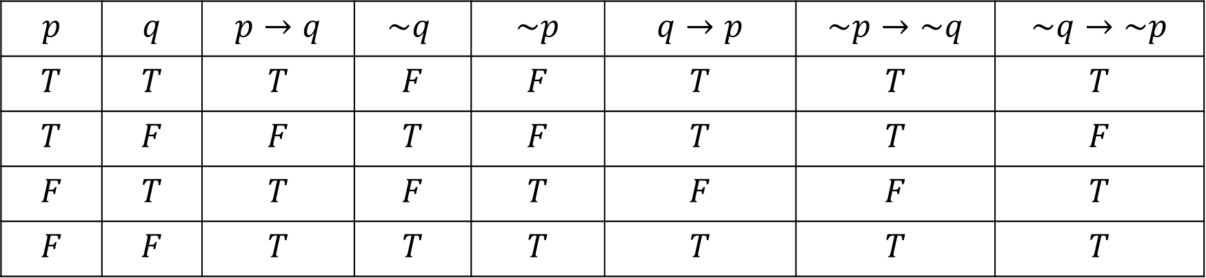
Example
A conditional statement and its contrapositive are equivalent. Also the converse and the inverse of a conditional statement are also equivalent.
$$p$$ | $$q$$ | $$p→q$$ | $$\sim q$$ | $$\sim p$$ | $$q→p$$ | $$\sim p→\sim q$$ | $$\sim q→\sim p$$
$$T$$ | $$T$$ | $$T$$ | $$F$$ | $$F$$ | $$T$$ | $$T$$ | $$T$$
$$T$$ | $$F$$ | $$F$$ | $$T$$ | $$F$$ | $$T$$ | $$T$$ | $$F$$
$$F$$ | $$T$$ | $$T$$ | $$F$$ | $$T$$ | $$F$$ | $$F$$ | $$T$$
$$F$$ | $$F$$ | $$T$$ | $$T$$ | $$T$$ | $$T$$ | $$T$$ | $$T$$

Slide 28
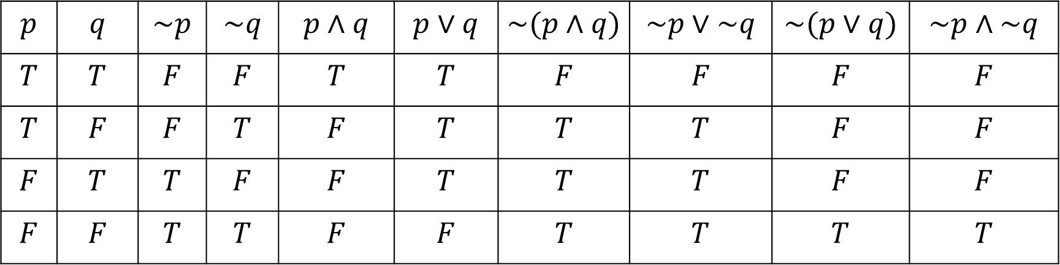

De Morgan’s Laws
$\sim \left(p∧q\right)≡\sim p∨\sim q and \sim \left(p∨q\right)≡\sim p∧\sim q.$
$$p$$ | $$q$$ | $$\sim p$$ | $$\sim q$$ | $$p∧q$$ | $$p∨q$$ | $$\sim (p∧q)$$ | $$\sim p∨\sim q$$ | $$\sim (p∨q)$$ | $$\sim p∧\sim q$$
$$T$$ | $$T$$ | $$F$$ | $$F$$ | $$T$$ | $$T$$ | $$F$$ | $$F$$ | $$F$$ | $$F$$
$$T$$ | $$F$$ | $$F$$ | $$T$$ | $$F$$ | $$T$$ | $$T$$ | $$T$$ | $$F$$ | $$F$$
$$F$$ | $$T$$ | $$T$$ | $$F$$ | $$F$$ | $$T$$ | $$T$$ | $$T$$ | $$F$$ | $$F$$
$$F$$ | $$F$$ | $$T$$ | $$T$$ | $$F$$ | $$F$$ | $$T$$ | $$T$$ | $$T$$ | $$T$$

Slide 29
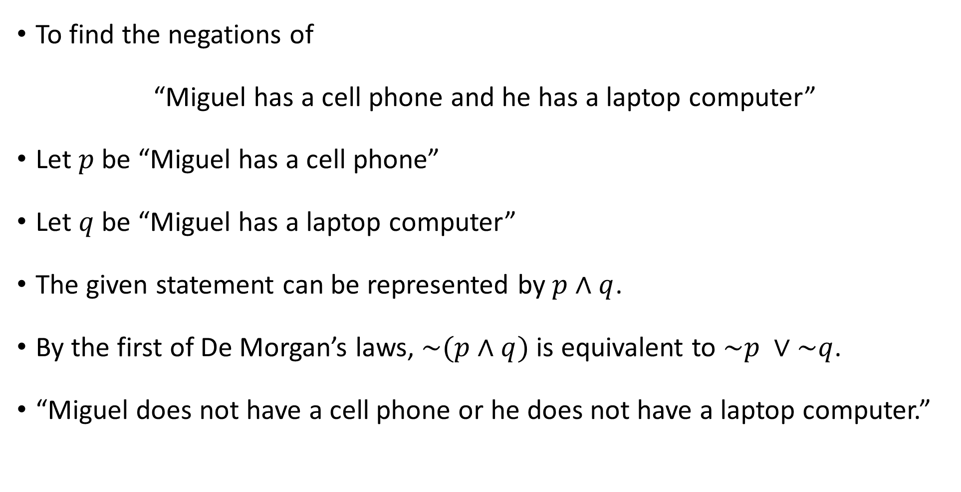
Example
To find the negations of
“Miguel has a cell phone and he has a laptop computer”
Let $p$ be “Miguel has a cell phone”
Let $q$ be “Miguel has a laptop computer”
The given statement can be represented by$p∧q$.
By the first of De Morgan’s laws, $\sim (p∧q)$is equivalent to $\sim p ∨\sim q$.
“Miguel does not have a cell phone or he does not have a laptop computer.”

Slide 30
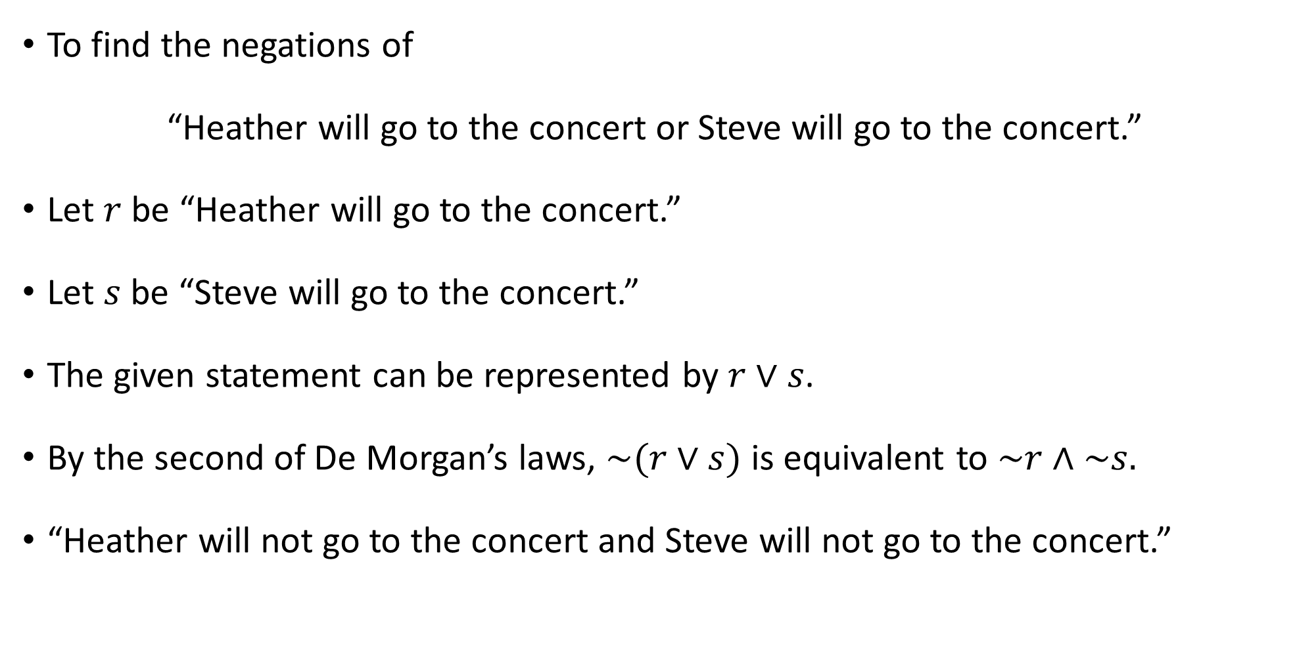
Example
To find the negations of
“Heather will go to the concert or Steve will go to the concert.”
Let $r$ be “Heather will go to the concert.”
Let $s$ be “Steve will go to the concert.”
The given statement can be represented by $r∨s$.
By the second of De Morgan’s laws, $\sim (r∨s)$ is equivalent to $\sim r∧\sim s.$
“Heather will not go to the concert and Steve will not go to the concert.”

Slide 31
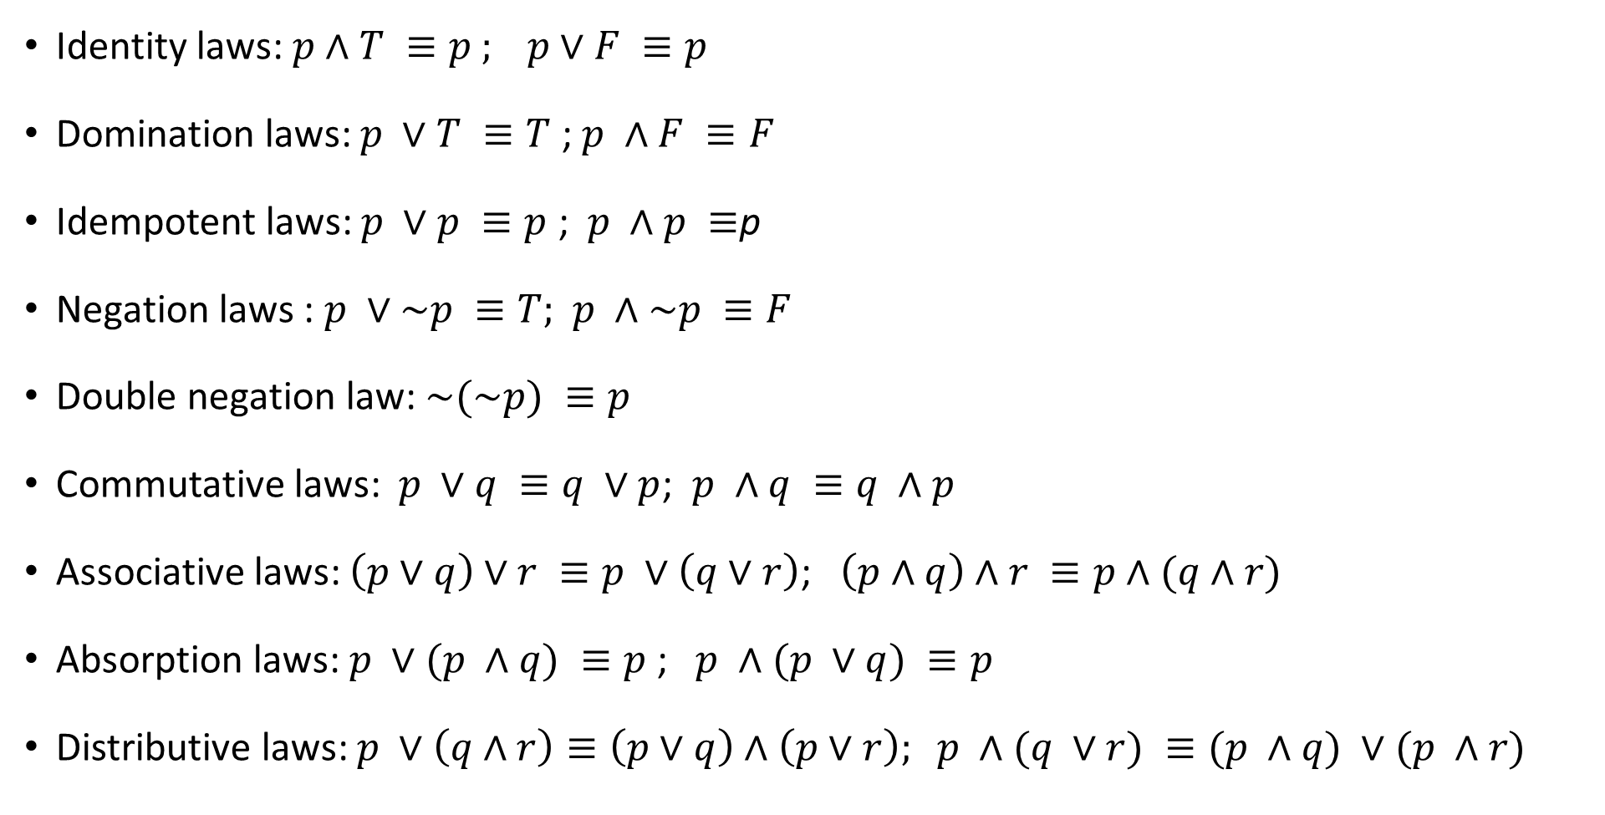
Some Important Equivalence
Identity laws:$p∧T ≡p$ $; p∨F ≡p$
Domination laws: $p ∨T ≡T$ ; $p ∧F ≡F$
Idempotent laws: $p ∨p ≡p$ ; $p ∧p ≡$p
Negation laws : $p ∨\sim p ≡T;$ $p ∧\sim p ≡F$
Double negation law: $\sim (\sim p) ≡p$
Commutative laws: $p ∨q ≡q ∨p$; $p ∧q ≡q ∧p$
Associative laws: $\left(p∨q\right)∨r ≡p ∨\left(q∨r\right)$; $\left(p∧q\right)∧r ≡p∧(q∧r)$
Absorption laws:$p ∨(p ∧q) ≡p$ ; $p ∧(p ∨q) ≡p$
Distributive laws: $p ∨\left(q∧r\right)≡\left(p∨q\right)∧\left(p∨r\right); p ∧(q ∨r) ≡(p ∧q) ∨(p ∧r)$

Slide 32
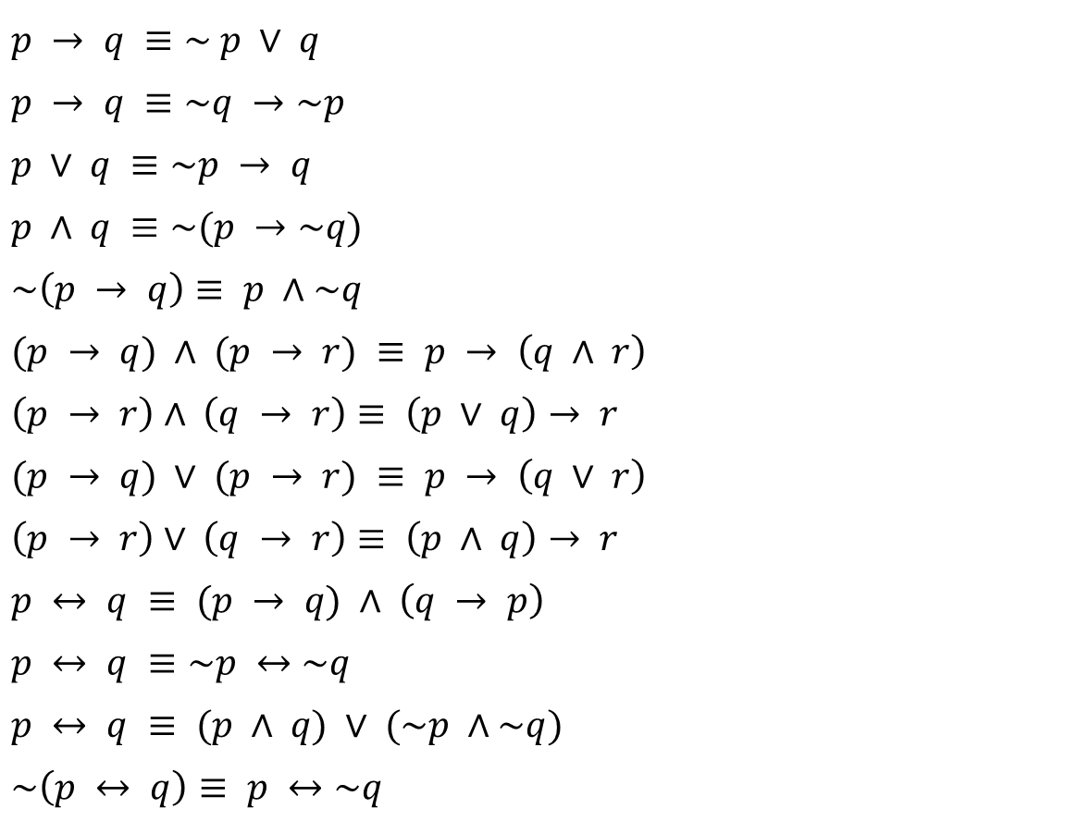
Some more Logical Equivalences
$p → q ≡\sim p ∨ q$
$p → q ≡\sim q →\sim p$
$p ∨ q ≡\sim p → q$
$p ∧ q ≡\sim (p →\sim q)$
$\sim \left(p → q\right)≡ p ∧\sim q$
$(p → q) ∧ (p → r) ≡ p → \left(q ∧ r\right)$
$\left(p → r\right)∧ \left(q → r\right)≡ \left(p ∨ q\right)→ r$
$(p → q) ∨ (p → r) ≡ p → \left(q ∨ r\right)$
$\left(p → r\right)∨ \left(q → r\right)≡ \left(p ∧ q\right)→ r$
$p ↔ q ≡ (p → q) ∧ \left(q → p\right)$
$p ↔ q ≡\sim p ↔\sim q$
$p ↔ q ≡ (p ∧ q) ∨ (\sim p ∧\sim q)$
$\sim \left(p ↔ q\right)≡ p ↔\sim q$

Slide 33
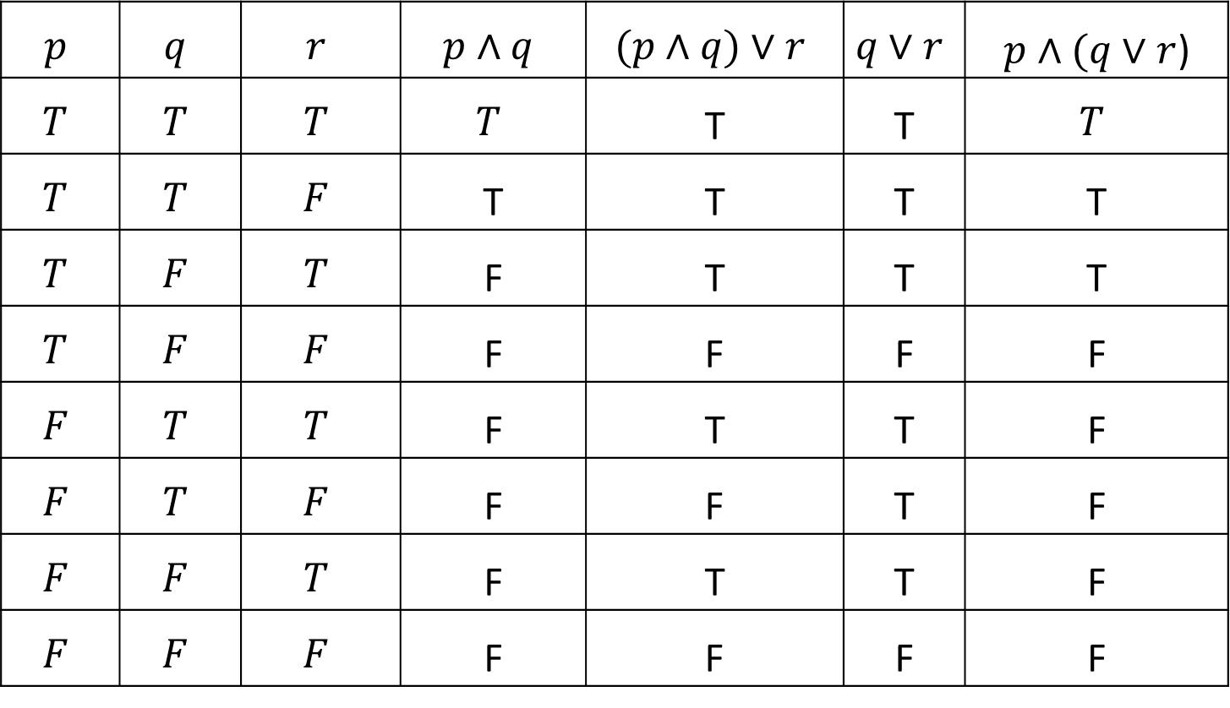

Well formed formula
$$p$$ | $$q$$ | $$r$$ | $$p∧q$$ | $$(p∧q)∨r$$ | $$q∨r$$ | $p∧(q∨r$)
$$T$$ | $$T$$ | $$T$$ | $$T$$ | T | T | $$T$$
$$T$$ | $$T$$ | $$F$$ | T | T | T | T
$$T$$ | $$F$$ | $$T$$ | F | T | T | T
$$T$$ | $$F$$ | $$F$$ | F | F | F | F
$$F$$ | $$T$$ | $$T$$ | F | T | T | F
$$F$$ | $$T$$ | $$F$$ | F | F | T | F
$$F$$ | $$F$$ | $$T$$ | F | T | T | F
$$F$$ | $$F$$ | $$F$$ | F | F | F | F
$p∧q∨r$
$(p∧q)∨r$
$p∧(q∨r$)

Slide 34
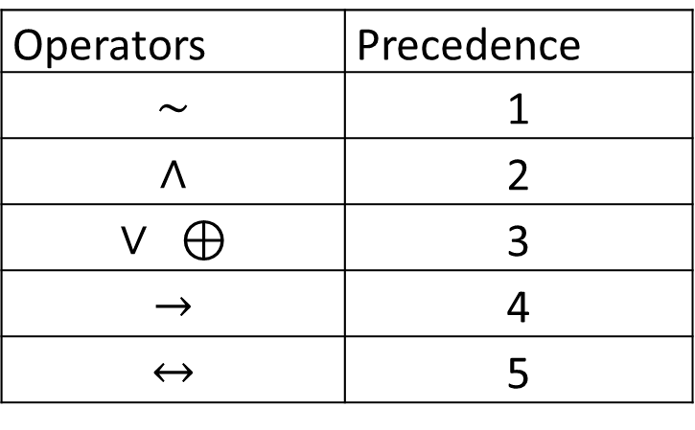
Rules of Precedence
Operators | Precedence
$$\sim$$ | 1
$$∧$$ | 2
$$∨ ⊕$$ | 3
$$→$$ | 4
$$↔$$ | 5

Slide 35
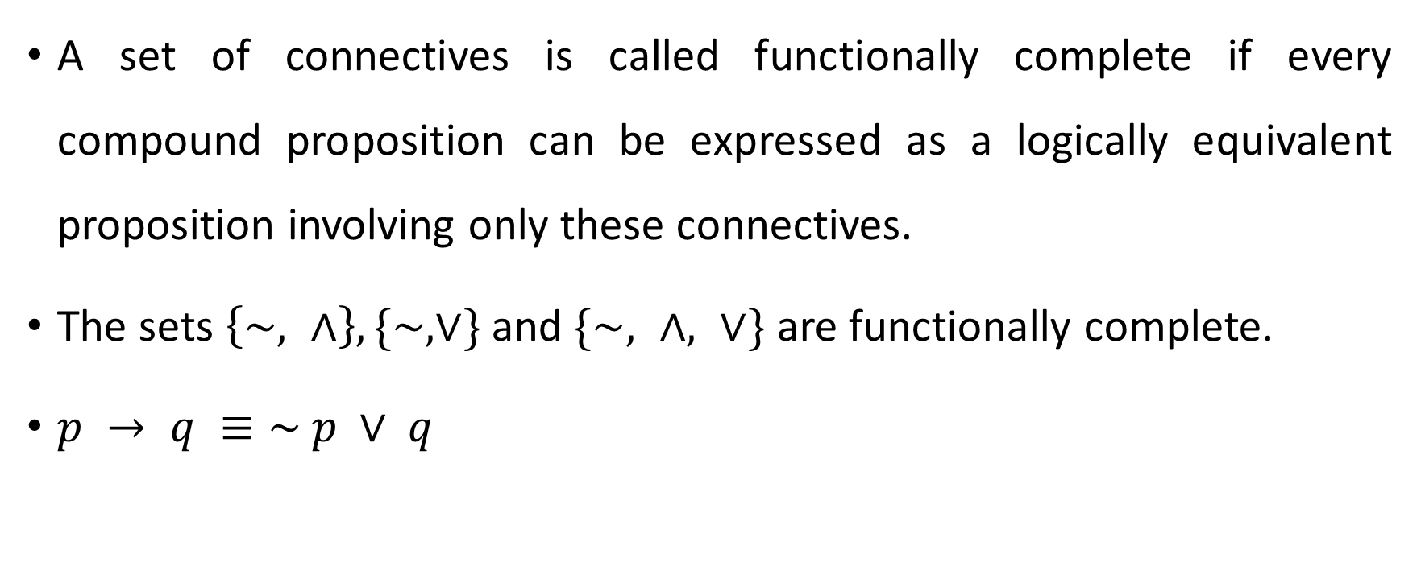
Functionally complete set of connectives
A set of connectives is called functionally complete if every compound proposition can be expressed as a logically equivalent proposition involving only these connectives.
The sets $\left\{\sim , ∧\right\}, \{\sim ,∨\}$ and $\{\sim , ∧, ∨\}$ are functionally complete.
$p → q ≡\sim p ∨ q$

Slide 36
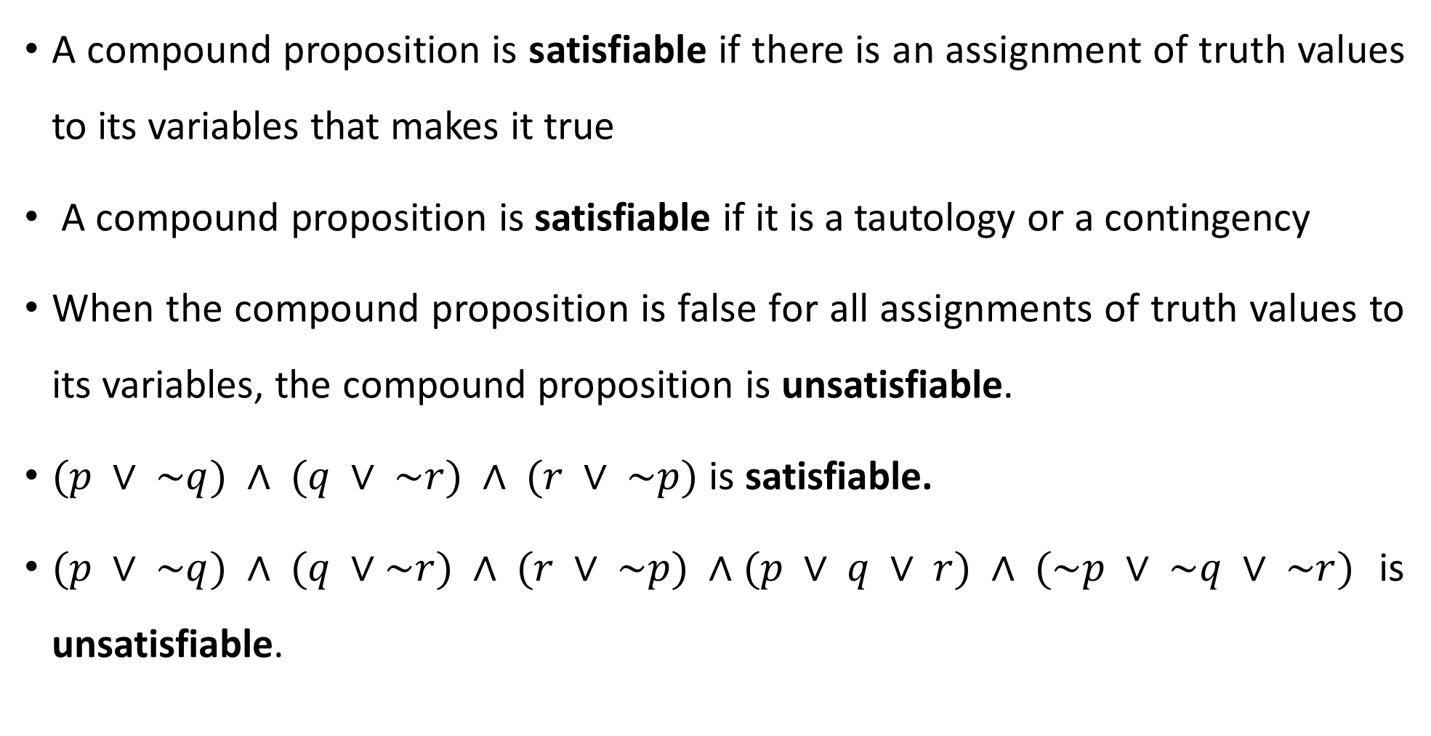
Satisfiable
A compound proposition is satisfiable if there is an assignment of truth values to its variables that makes it true
A compound proposition is satisfiable if it is a tautology or a contingency
When the compound proposition is false for all assignments of truth values to its variables, the compound proposition is unsatisfiable.
$(p ∨ \sim q) ∧ (q ∨ \sim r) ∧ (r ∨ \sim p)$ is satisfiable.
$(p ∨ \sim q) ∧ (q ∨\sim r) ∧ (r ∨ \sim p) ∧(p ∨ q ∨ r) ∧ (\sim p ∨ \sim q ∨ \sim r)$ is unsatisfiable.

Slide 37
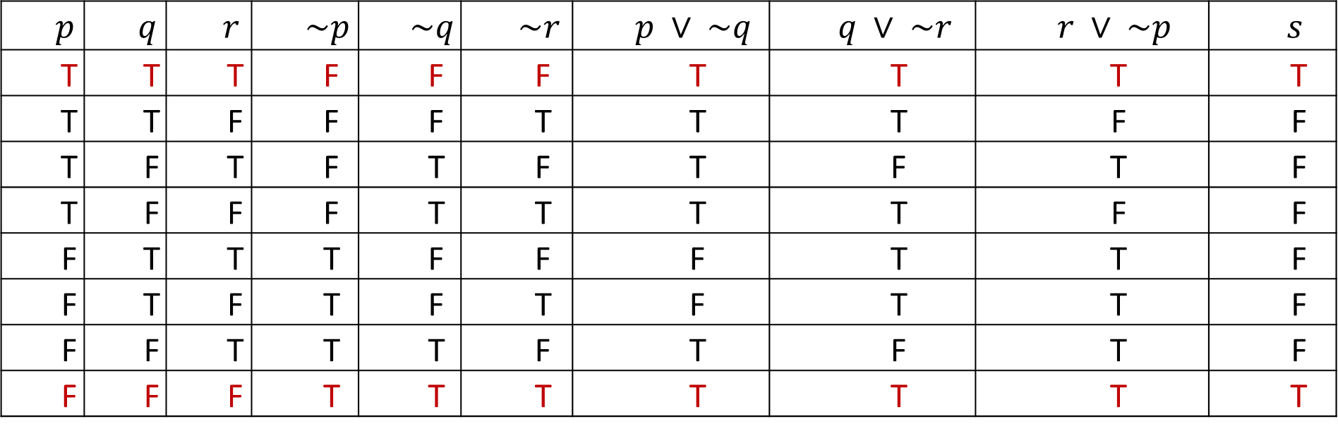
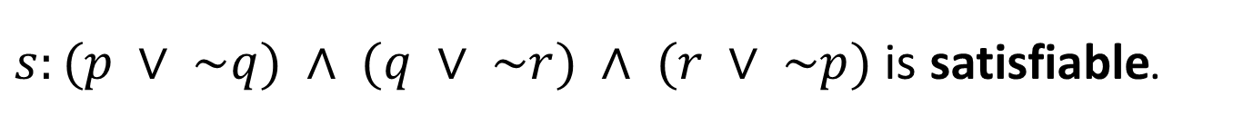
Example
$s:(p ∨ \sim q) ∧ (q ∨ \sim r) ∧ (r ∨ \sim p)$ is satisfiable.
$$p$$ | $$q$$ | $$r$$ | $$\sim p$$ | $$\sim q$$ | $$\sim r$$ | $$p ∨ \sim q$$ | $$q ∨ \sim r$$ | $$r ∨ \sim p$$ | $$s$$
T | T | T | F | F | F | T | T | T | T
T | T | F | F | F | T | T | T | F | F
T | F | T | F | T | F | T | F | T | F
T | F | F | F | T | T | T | T | F | F
F | T | T | T | F | F | F | T | T | F
F | T | F | T | F | T | F | T | T | F
F | F | T | T | T | F | T | F | T | F
F | F | F | T | T | T | T | T | T | T

Slide 38
Some Applications of Propositional Logic
Translating English Sentences
System Specifications
Logic Puzzles
Boolean Searches
Logic Circuits

Slide 39
Translating English Sentences
There are many reasons to translate English sentences into expressions involving propositional variables and logical connectives.
In particular, English is often ambiguous and translating sentences into compound statements removes the ambiguity.
Moreover, once we have translated sentences from English into logical expressions, we can analyze these logical expressions to determine their truth values and we can manipulate them.

Slide 40
System Specifications
Translating sentences in natural language (such as English) into logical expressions is an essential part of specifying both hardware and software systems.
System and software engineers take requirements in natural language and produce precise and unambiguous specifications that can be used as the basis for system development.
System specifications should be consistent, that is, they should not contain conflicting requirements that could be used to derive a contradiction.
When specifications are not consistent, there would be no way to develop a system that satisfies all specifications.

Slide 41
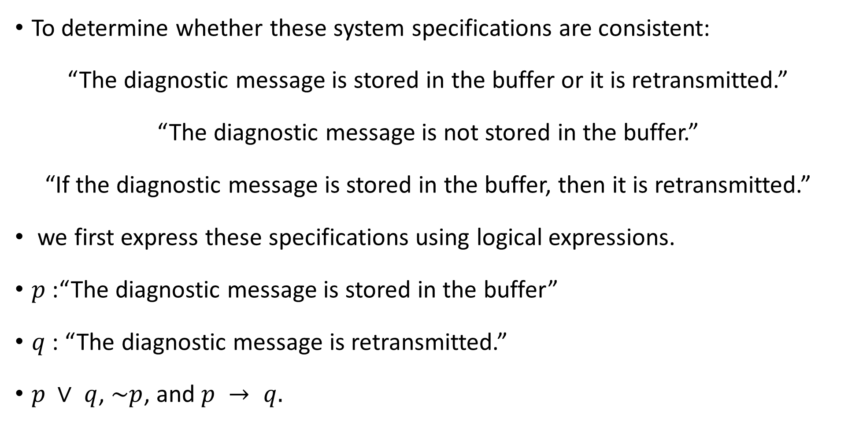
Example
To determine whether these system specifications are consistent:
“The diagnostic message is stored in the buffer or it is retransmitted.”
“The diagnostic message is not stored in the buffer.”
“If the diagnostic message is stored in the buffer, then it is retransmitted.”
we first express these specifications using logical expressions.
$p$ :“The diagnostic message is stored in the buffer”
$q$ : “The diagnostic message is retransmitted.”
$p ∨ q$, $\sim p$, and $p → q.$

Slide 42
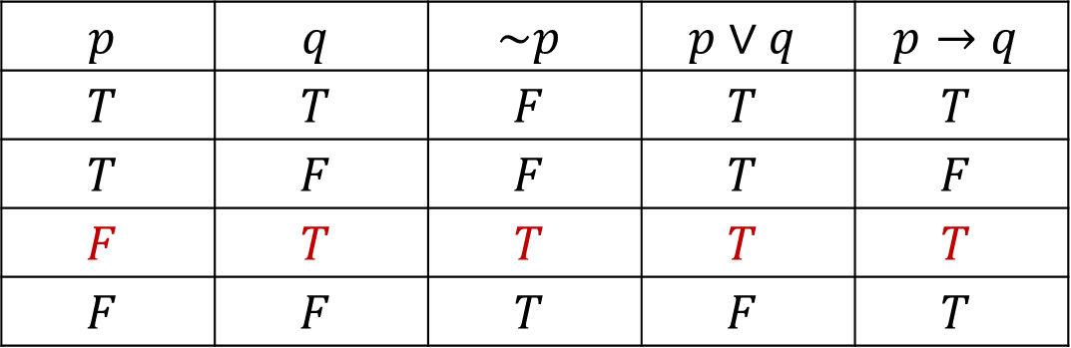
Example continued….
To find an assignment of truth values that makes all three specifications true:
$$p$$ | $$q$$ | $$\sim p$$ | $$p∨q$$ | $$p→q$$
$$T$$ | $$T$$ | $$F$$ | $$T$$ | $$T$$
$$T$$ | $$F$$ | $$F$$ | $$T$$ | $$F$$
$$F$$ | $$T$$ | $$T$$ | $$T$$ | $$T$$
$$F$$ | $$F$$ | $$T$$ | $$F$$ | $$T$$

Slide 43
Logic Puzzles
Puzzles that can be solved using logical reasoning are known as logic puzzles.
Solving logic puzzles is an excellent way to practice working with the rules of logic.
Also, computer programs designed to carry out logical reasoning often use well-known logic puzzles to illustrate their capabilities.

Slide 44
Example
A father tells his two children, a boy and a girl, to play in their backyard without getting dirty. However, while playing, both children get mud on their foreheads. When the children stop playing, the father says “At least one of you has a muddy forehead,” and then asks the children to answer “Yes” or “No” to the question: “Do you know whether you have a muddy forehead?” The father asks this question twice. What will the children answer each time this question is asked, assuming that a child can see whether his or her sibling has a muddy forehead, but cannot see his or her own forehead? Assume that both children are honest and that the children answer each question simultaneously.

Slide 45
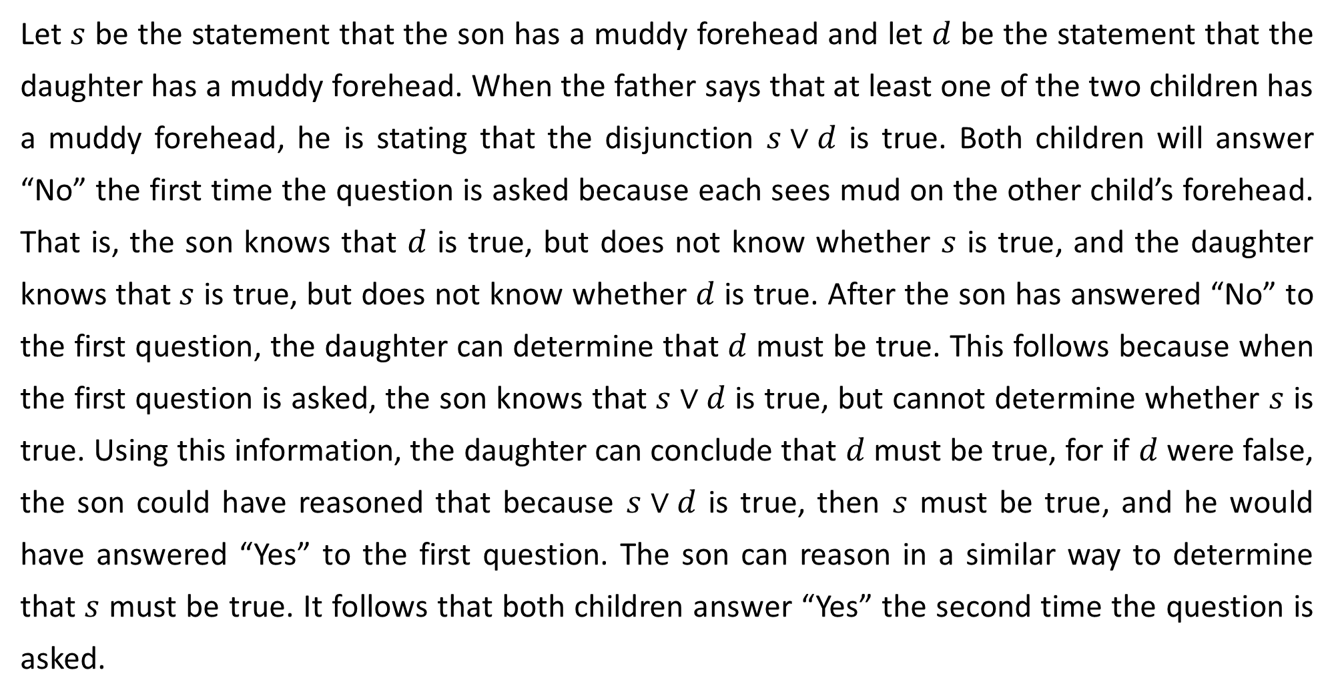
Example continued…
Let $s$ be the statement that the son has a muddy forehead and let $d$ be the statement that the daughter has a muddy forehead. When the father says that at least one of the two children has a muddy forehead, he is stating that the disjunction $s∨d$ is true. Both children will answer “No” the first time the question is asked because each sees mud on the other child’s forehead. That is, the son knows that $d$ is true, but does not know whether $s$ is true, and the daughter knows that $s$ is true, but does not know whether $d$ is true. After the son has answered “No” to the first question, the daughter can determine that $d$ must be true. This follows because when the first question is asked, the son knows that $s∨d$ is true, but cannot determine whether $s$ is true. Using this information, the daughter can conclude that $d$ must be true, for if $d$ were false, the son could have reasoned that because $s∨d$ is true, then $s$ must be true, and he would have answered “Yes” to the first question. The son can reason in a similar way to determine that $s$ must be true. It follows that both children answer “Yes” the second time the question is asked.

Slide 46
Boolean Searches
Logical connectives are used extensively in searches of large collections of information, such as indexes of Web pages.
Because these searches employ techniques from propositional logic, they are called Boolean searches.
The connective AND is used to match records that contain both of two search terms.
The connective OR is used to match one or both of two search terms
the connective NOT is used to exclude a particular search term.

Slide 47
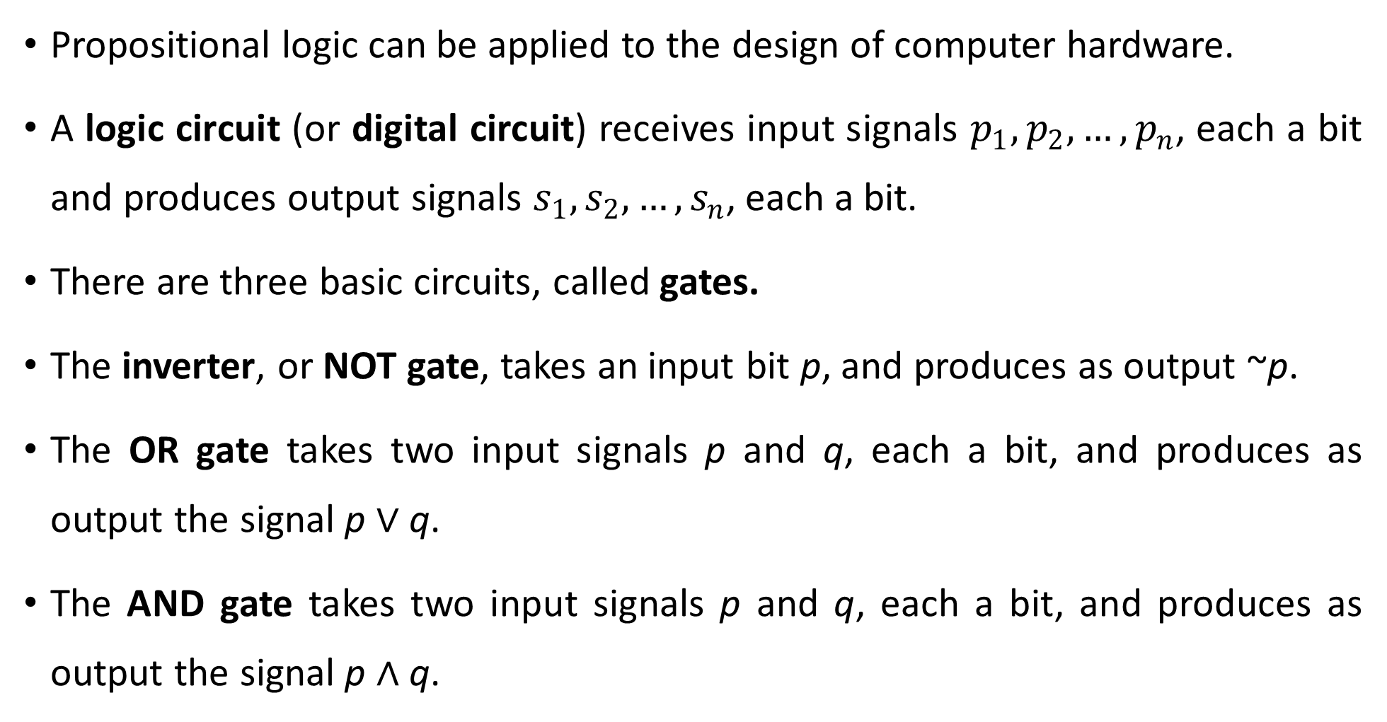
Logic Circuits
Propositional logic can be applied to the design of computer hardware.
A logic circuit (or digital circuit) receives input signals $p_{1}, p_{2},…, p_{n}$, each a bit and produces output signals $s_{1}, s_{2},…, s_{n}$, each a bit.
There are three basic circuits, called gates.
The inverter, or NOT gate, takes an input bit p, and produces as output ~p.
The OR gate takes two input signals p and q, each a bit, and produces as output the signal p ∨ q.
The AND gate takes two input signals p and q, each a bit, and produces as output the signal p ∧ q.

Slide 48
Three gates

Slide 49
Argument
An argument in propositional logic is a sequence of propositions,
In an argument all but the final proposition are called premises and the final proposition is called the conclusion.
An argument is valid if all its premises are true implies that the conclusion is true.
An argument form in propositional logic is a sequence of compound propositions involving propositional variables.
An argument form is valid no matter which particular propositions are substituted for the propositional variables in its premises; the conclusion is true if the premises are all true.

Slide 50
Example
“If you have a current password, then you can log onto the network.”
“You have a current password.”
Therefore, “You can log onto the network.”
Here the premises are
“If you have a current password, then you can log onto the network.”
And
“You have a current password.”
The conclusion is
“You can log onto the network”

Slide 51
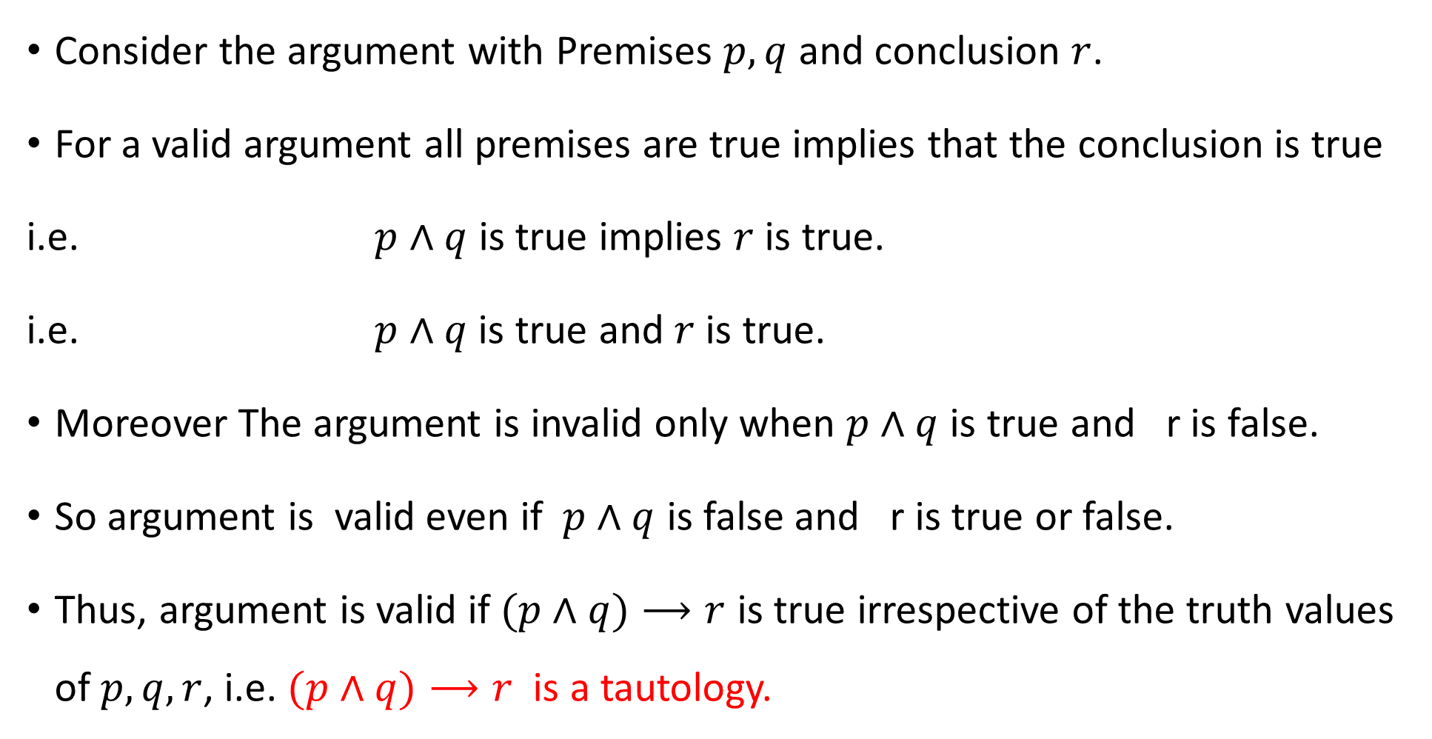
Valid Argument
Consider the argument with Premises $p, q$ and conclusion $r$.
For a valid argument all premises are true implies that the conclusion is true
i.e. $p∧q$ is true implies $r$ is true.
i.e. $p∧q$is true and $r$ is true.
Moreover The argument is invalid only when $p∧q$ is true and r is false.
So argument is valid even if $p∧q$ is false and r is true or false.
Thus, argument is valid if $(p∧q)⟶r$ is true irrespective of the truth values of $p,q,r$, i.e. $(p∧q)⟶r$ is a tautology.

Slide 52
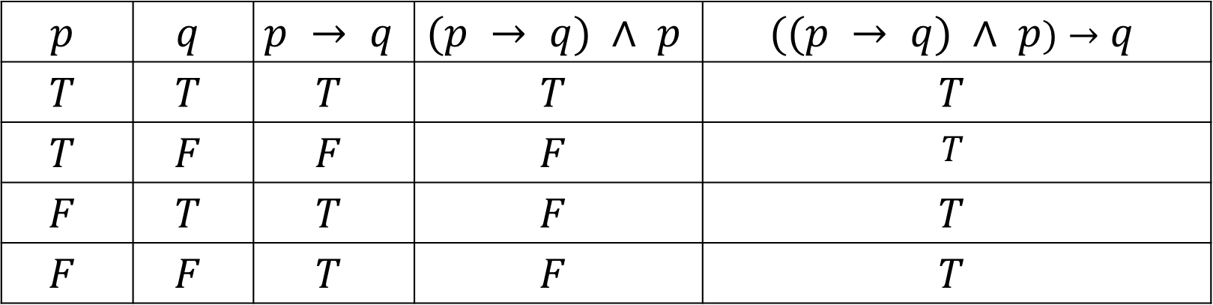

Example
Consider the argument:
$$p → q$$
$$p$$
$$_________________$$
$∴ q$
The argument is valid.
$$p$$ | $$q$$ | $$p → q$$ | $$(p → q) ∧ p$$ | $$((p → q) ∧ p)→q$$
$$T$$ | $$T$$ | $$T$$ | $$T$$ | $$T$$
$$T$$ | $$F$$ | $$F$$ | $$F$$ | $$T$$
$$F$$ | $$T$$ | $$T$$ | $$F$$ | $$T$$
$$F$$ | $$F$$ | $$T$$ | $$F$$ | $$T$$

Slide 53
Rules of Inference for Propositional Logic
Some simple valid argument forms are called rules of inference.
These rules are our basic tools for establishing the truth of statements and validity of other argument forms.
To deduce new statements from statements we already have, we use rules of inference.
These rules of inference can be used as building blocks to construct more complicated valid argument forms.

Slide 54
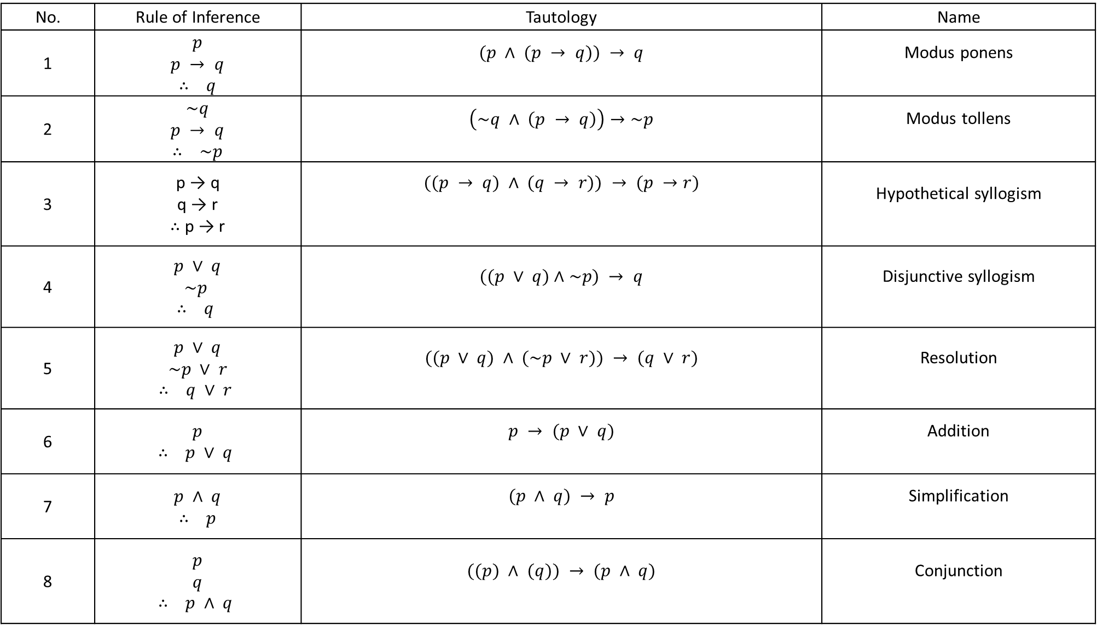
No. | Rule of Inference | Tautology | Name
1 | $p$ $p → q$ $∴ q$ | $$(p ∧ (p → q)) → q$$ | Modus ponens
2 | $\sim q$ $p → q$ $∴ \sim p$ | $$\left(\sim q ∧ \left(p → q\right)\right)→\sim p$$ | Modus tollens
3 | p → q q → r ∴ p → r | $$((p → q) ∧ (q → r)) → (p →r)$$ | Hypothetical syllogism
4 | $p ∨ q$ $\sim p$ $∴ q$ | $$((p ∨ q)∧\sim p) → q$$ | Disjunctive syllogism
5 | $p ∨ q$ $\sim p ∨ r$ $∴ q ∨ r$ | $$((p ∨ q) ∧ (\sim p ∨ r)) → (q ∨ r)$$ | Resolution
6 | $p$ $∴ p ∨ q$ | $$p → (p ∨ q)$$ | Addition
7 | $p ∧ q$ $∴ p$ | $$(p ∧ q) → p$$ | Simplification
8 | $p$ $q$ $∴ p ∧ q$ | $$((p) ∧ (q)) → (p ∧ q)$$ | Conjunction

Slide 55
Example
The premises
“It is not sunny this afternoon and it is colder than yesterday,”
“We will go swimming only if it is sunny,”
“If we do not go swimming, then we will take a canoe trip,” and
“If we take a canoe trip, then we will be home by sunset”
lead to the conclusion
“We will be home by sunset.”

Slide 56

Example continued…
$p$: “It is sunny this afternoon,”
$q$: “It is colder than yesterday,”
$r:$“We will go swimming,”
$s:$ “We will take a canoe trip,”
$t$: “We will be home by sunset.”

Slide 57

Example continued…
“It is not sunny this afternoon and it is colder than yesterday,”---$\sim p ∧ q$
“We will go swimming only if it is sunny,”---- $r → p$
“If we do not go swimming, then we will take a canoe trip,” ---- $\sim r → s$
“If we take a canoe trip, then we will be home by sunset” ----- $s→ t$
“We will be home by sunset.”---- $t$
We need to show it is a valid argument with premises $\sim p ∧ q, r → p, \sim r → s,$ and $s →$t and conclusion $t$.

Slide 58

Example continued…
Step 1
$\sim p ∧ q$ Premise (1)
_____________________
$∴\sim p$ simplification
Step 2
$r → p$ Premise (2)
$\sim p$ Step 1
_______________________
$∴\sim r$ Modus tollens
Step 3
$\sim r → s$ Premise(3)
$\sim r$ step 2
____________________
$∴s$ Modus ponens
Step 4
$s → t$ Premise(4)
$s$ step 4
_____________________
$∴t$ Modus ponens(conclusion)

Slide 59
Fallacies
Several common fallacies (mistaken believes) arise in incorrect arguments.
These fallacies resemble rules of inference, but are based on contingencies rather than tautologies.
“Rahul is different from Raj."
“Raj is a man."
"Therefore, Rahul is different from a man.

Slide 60
Limitations of Propositional logic
Propositional logic cannot adequately express the meaning of all statements in mathematics and in natural language.
For example,
“Every computer connected to the university network is functioning properly.”
And
“MATH3 is one of the computers connected to the university network.
No rules of propositional logic allow us to conclude the truth of the statement
“MATH3 is functioning properly,”

Slide 61
Predicate Logic
It is a more powerful type of logic that can be used to express the meaning of a wide range of statements in mathematics and computer science.
To understand predicate logic, we first need to introduce the concept of predicates and quantifiers .
These enable us to reason with statements that assert that a certain property holds for all objects of a certain type and with statements that assert the existence of an object with a particular property.

Slide 62
Predicates and Quantifiers
Predicates is the part of a sentence or clause containing a verb and stating something about the subject.
Quantifier is a determiner or pronoun indicative of quantity.
Example:
“Every student in this class has enrolled for Discrete mathematics.”
Predicate: ‘has enrolled for Discrete mathematics’
Quantifier: ‘Every’

Slide 63

Propositional function
“$x$ is greater than 3”
The first part, the variable $x$, is the subject of the statement.
The second part—the predicate, “is greater than 3”.
$P(x)$: “$x$ is greater than 3.”
$P$ denotes the predicate and is called propositional function.
Once a value has been assigned to the variable $x$, the statement $P(x)$ becomes a proposition and has a truth value.
$P(5)$ is true and $P(1)$ is false.

Slide 64

Example
Let P$(x)$be the statement “the word $x$ contains the letter a.” What are the truth values of the following propositions?
P(orange) , P(lemon), P(true) , P(false).
Ans:
P(orange) is true.
P(lemon) is false.
P(true) is false.
P(false) is true.

Slide 65

The Universal Quantifier
The universal quantification of $P(x)$ is the statement
“$P(x)$ for all values of $x$ in the domain.”
The notation “$∀x P(x)$” denotes the universal quantification of $P(x).$ i.e.
$∀x P(x)$ : $P(x)$ for all values of $x$ in the domain.
$∀$ is called the universal quantifier and the domain is called domain of discourse.
An element for which $P(x)$ is false is called a counterexample of $∀x P(x).$

Slide 66

Example
Express the statement “Every student in this class has studied calculus” using predicates and quantifiers.
First, we rewrite the statement so that we can clearly identify the appropriate quantifiers to use.
“For every student in this class, that student has studied calculus.”
Next, we introduce a variable $x$ so that our statement becomes
“For every student $x$ in this class, $x$ has studied calculus.”
Again, we introduce propositional function $C(x)$, which is the statement “$x$ has studied calculus.”
Consequently, if the domain for $x$ consists of the students in the class, we can translate our statement as $∀x C(x)$. i.e.
$∀x C\left(x\right):$Every student in this class has studied calculus

Slide 67

Example
Let $P(x)$ be the statement $“x + 1 > x.”$
What is the truth value of the quantification $∀x P(x),$where the domain consists of all real numbers?
Because $P(x)$ is true for all real numbers $x$, the quantification $∀x P(x)$ is true.

Slide 68

Example
Let $P(x)$ be the statement $“x^{2}≥ x.”$
What is the truth value of the quantification $∀x P(x),$where the domain consists of all real numbers?
Because $P\left(\frac{1}{2}\right)$ is false, the quantification $∀x P(x)$ is false.
$x=\frac{1}{2}$ is a counterexample for the statement $∀x P(x).$

Slide 69

The Existential Quantifier:
The existential quantification of $P(x)$ is the proposition
“There exists an element $x$ in the domain such that $P(x)$ .”
We use the notation $∃x P(x)$for the existential quantification of $P(x).$
Here $∃$ is called the existential quantifier.
A domain must always be specified when a statement $∃x P(x)$is used.
Furthermore, the meaning of $∃x P(x)$ changes when the domain changes.

Slide 70

Example
Express the statements “Some student in this class has visited Mexico”, using predicates and quantifiers.
The statement can be written by introducing a variable $x$
“There is a student $x$in this class having the property that $x$ has visited Mexico.”
We introduce propositional function $M(x)$: $x$ has visited Mexico.
If the domain consistsof the students in this class, the given statement expressed as
$$∃x M(x).$$

Slide 71

Example
Let $P(x)$ be the statement $“x^{2}≥ x.”$
What is the truth value of the quantification $∃x P(x),$where the domain consists of all real numbers?
Because $P\left(2\right)$ is true, the quantification $∃x P(x)$ is true.

Slide 72

Example
Let $P(x)$ be the statement $“x + 1< x.”$
What is the truth value of the quantification $∃x P(x),$where the domain consists of all real numbers?
Because there is no real number $x$, for which $P(x)$ is true, the quantification $∃x P(x)$ is false.

Slide 73

Quantifiers Over Finite Domains
When the domain of a quantifier is finite, quantified statements can be expressed using propositional logic.
Let the domain consist of elements are $x_{1}, x_{2},…, x_{n},$ where$n$ is a positive integer.
the universal quantification $∀x P(x)$ is the same as the conjunction
$$P\left(x_{1}\right)∧ P\left(x_{2}\right)∧⋯∧ P\left(x_{n}\right).$$
Similarly the existential quantification $∃x P\left(x\right)$ is the same as the conjunction
$$P\left(x_{1}\right)∨ P\left(x_{2}\right)∨⋯∨ P\left(x_{n}\right).$$

Slide 74

Quantifiers with Restricted Domains
Let P$(x)$ be the proposition “ $x$ has a particular property.”
Let $Q(x)$ be the proposition “ $x$is in $A$.”
The proposition “For every $x$ in $A$, $P(x)$” is written as
“For all $x$, if it is in $A$, then $P(x)$.”
i.e.
$∀x \left(Q\left(x\right)→P\left(x\right)\right)$.
The standard way of writing the restricted domain statement $∀x (Q\left(x\right)→P\left(x\right))$ is
$∀x∈A P(x)$.

Slide 75

Quantifiers with Restricted Domains
The restricted domain statement $∃x∈A P(x)$ reads,
"There exists some $x$ in $A$, where the predicate $P(x)$ holds".
This is equivalent to saying,
"There exists some $x$, that is in $A$and the predicate $P(x)$ holds."
Which is same as
$∃x (Q(x)∧ P(x))$.

Slide 76

Logical Equivalences Involving Quantifiers
Statements involving predicates and quantifiers are logically equivalent if and only if they have the same truth value no matter which predicates are substituted into these statements and which domain of discourse is used for the variables in these propositional functions.
$∀x(P(x) ∧ Q(x))$and $∀xP(x) ∧ ∀xQ(x)$ are logically equivalent.
Note: The quantifiers $∀$ and $∃$ have higher precedence than all logical operators from propositional calculus.

Slide 77

Negating Quantified Expressions or De Morgan’s laws for quantifiers.
$\sim ∀xP\left(x\right) ≡ ∃x(\sim P\left(x\right)).$
$\sim ∃x Q\left(x\right)≡ ∀x \sim Q(x).$

Slide 78

Example
Find the negations of the statements “There is an honest politician” and “All Indians eat rice.”
Let $H(x)$denote “$x$ is honest.”
The statement “There is an honest politician” is represented by $∃x H(x)$, where the domain consists of all politicians.
The negation of this statement is $\sim ∃x H(x)$, which is equivalent to $∀x\sim H(x)$.
This negation can be expressed as
“Every politician is dishonest.”
Let $R(x)$ denote “$x$ eats rice.”
Then the statement “All Indians eat rice” is represented by $∀x R(x)$, where the domain consists of all Indians.
The negation of this statement is $\sim ∀x R(x)$, which is equivalent to $∃x \sim R(x)$.
This negation can be expressed as
“Some Indian does not eat rice.”

Slide 79

Using Quantifiers in System Specifications
Use predicates and quantifiers to express the system specifications
“All lions are fierce.”
“Some lions do not drink coffee.”
“Some fierce creatures do not drink coffee.”
Let $P(x), Q(x)$, and $R(x)$be the statements “$x$ is a lion,” “$x$ is fierce,” and “$x$drinks coffee,” respectively.
We assume that the domain consists of all creatures
$∀x (P(x) → Q(x)).$
$∃x (P(x) ∧\sim R(x)).$
$∃x (Q(x) ∧\sim R(x)).$

Slide 80

Rules of Inference for Quantified Statements
Rule of Inference | Name
$$∀xP(x)$$ $$∴ P(c)$$ | Universal instantiation
$P(c)$ for an arbitrary c $$∴ ∀xP(x)$$ | Universal generalization
$$∃xP(x)$$ $∴ P(c)$ for some element c | Existential instantiation
$P(c)$ for some element c $$∴ ∃xP(x)$$ | Existential generalization

Slide 81

Example
Show that the premises “A student in this class has not read the book,” and “Everyone in this class passed the first exam” imply the conclusion “Someone who passed the first exam has not read the book.”
C(x) : “x is in this class,”
B(x) : “x has read the book,”
P(x) : “x passed the first exam.”
The premises are
$∃x(C(x)∧\sim B(x))$
(ii) $∀x(C(x) → P(x))$
The conclusion is
$∃x(P(x)∧\sim B(x)).$

Slide 82

Example
Step 1 Reason
$∃x(C(x)∧\sim B(x))$ Premise (i)
___________________________________________
$∴C\left(a\right)∧\sim B(a)$ Existential instantiation
Step 2 Reason
$C\left(a\right)∧\sim B(a)$ step 1
___________________________________________
$∴C(a)$ Simplification
Step 3 Reason
$C\left(a\right)∧\sim B(a)$ step 1
____________________________________
$∴\sim B(a)$ Simplification
Step 4 Reason
$∀x(C(x) → P(x))$ Premise (ii)
____________________________________
$∴C(a) → P(a)$ Universal instantiation
Step 5 Reason
$C(a) → P(a)$ step 3
C(a) step 2
___________________________________________
$∴P(a)$ Modus ponens
Step 6 Reason
P(a) step 5
$\sim B(a)$ step 3
_______________________________________
$∴P\left(a\right)∧\sim B(a)$ Conjunction
Step 7 Reason
$P\left(a\right)∧\sim B(a)$ step 6
___________________________________________
$∴∃x(P(x)∧\sim B(x))$ Existential generalization

Slide 83

Combining Rules of Inference for Propositions and Quantified Statements
Universal modus ponens
$∀x(P(x) → Q(x))$
$P(a)$, where $a$ is a particular element in the domain
______________________________________
$∴Q(a)$
Universal modus tollens
$∀x(P(x) → Q(x))$
$\sim Q(a)$, where $a$ is a particular element in the domain
_____________________________________________
$∴\sim P(a)$

Slide 84
Thank you

